Slide 1
A. Composition of Ocean Water
Ocean water is a mixture of gases and solids dissolved in water.

Slide 2
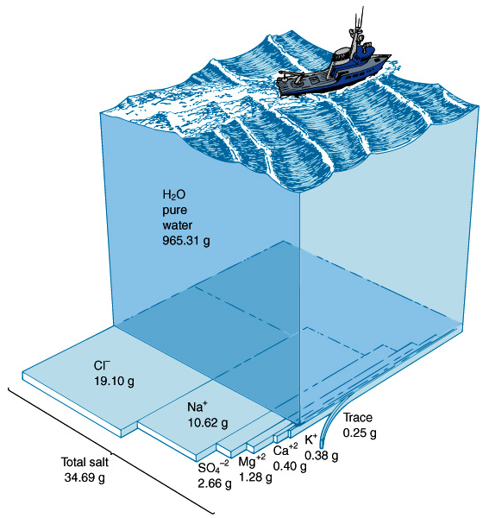
1. Gases: CO₂ and O₂
2. Solids: 3.5 % dissolved
minerals like:
Ca, Na, Fe, and Si.
3. Disassociate into ions:
+ Na, Ca, K, Mg
- Cl, SO₄, CO₃, OH

Slide 3
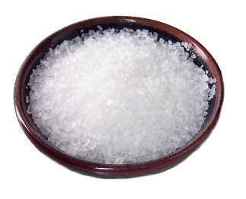
B. Salinity: The amount of dissolved salts in water. Measured in parts per thousand (ppt or o/oo) (#g/1,000g = #g/L).
1. NaCl is the major salt in the world ocean.
2. MgCl is the second most abundant salt in the ocean.
3. The average salinity of the ocean is 35 parts per thousand (ppt) .
Salinty ranges from 33 to 38 ppt
depending on evaporation and
fresh water input.

Slide 4
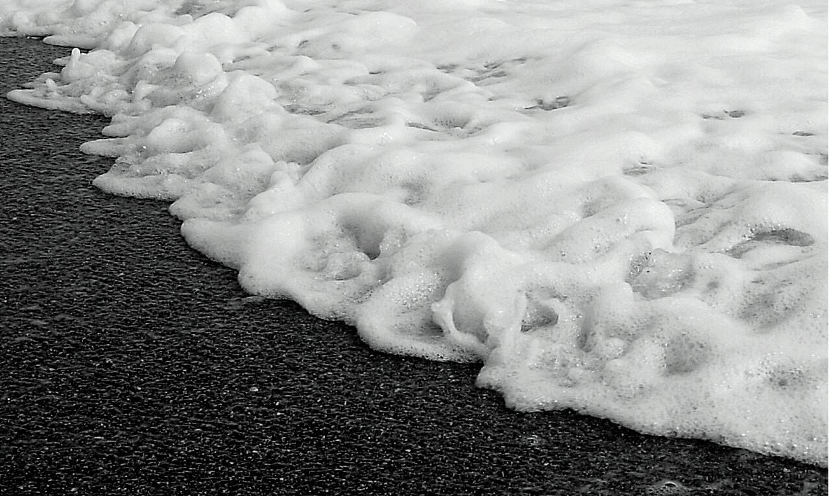

Slide 5
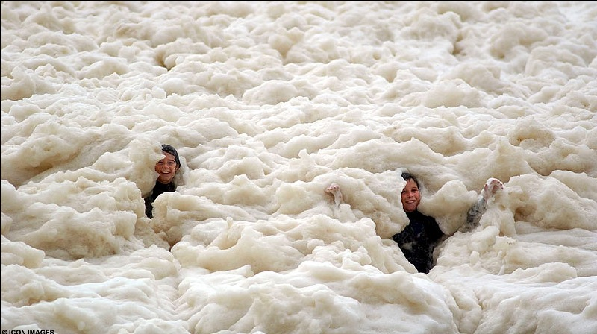

Slide 6
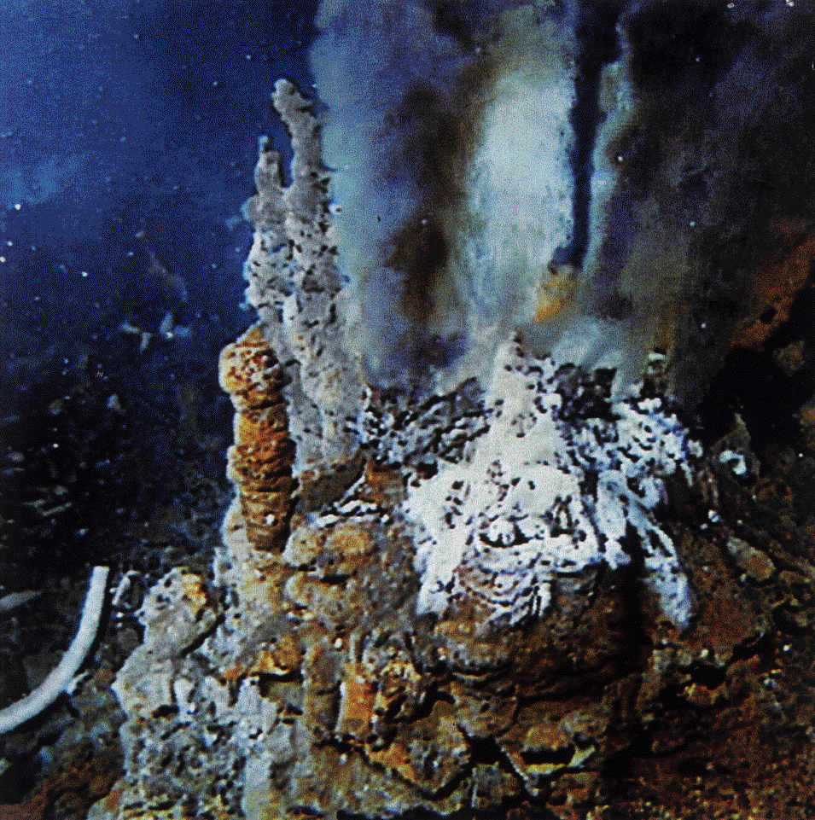
Source of Salts: Where did the Oceans get their salt?
a/ Volcanism in
the Oceans
release
H₂O, HCl (acid)
and CO₂
Original oceans
were acidic!

Slide 7
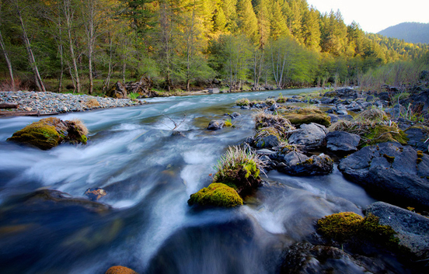
b/ Chemical Weathering of rocks release minerals Ca, Na, K, Mg
Rivers are alkaline (base).

Slide 8
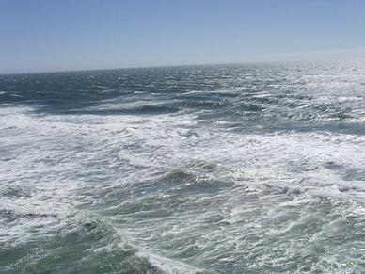
c/ Billions of years ago…. Rivers (base) reacted
with oceans (acid) in a neutralization reaction to
form salt and water!
d/ Salinity is currently constant!

Slide 9
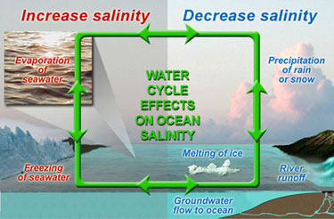
Factors Influencing Variations in Ocean Salinity

Slide 10
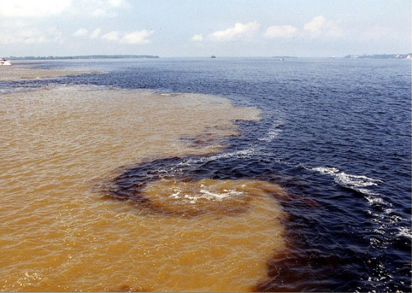
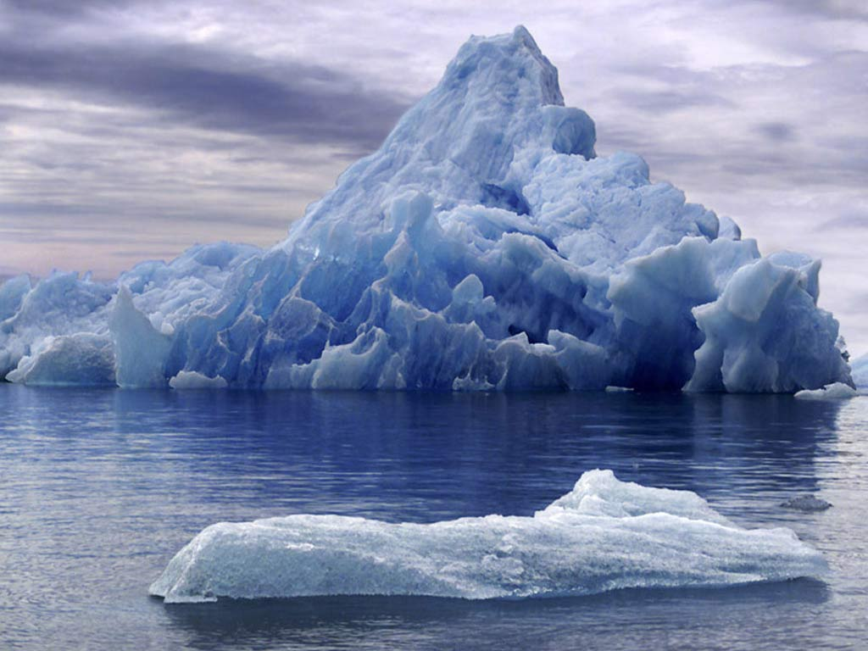
A/ Lower salinity occurs where more fresh water enters the oceans.
1/ Precipitation
2/ River runoff
3/ Melting of ice
4/ Groundwater flow to oceans

Slide 11
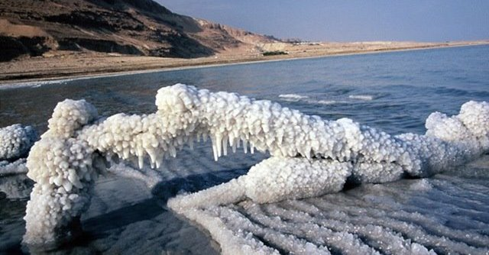
B/ Higher salinity occurs where fresh water is removed and less fresh water enters the oceans.
1/ Hot oceans where there
is little precipitation or
runoff and a lot of
evaporation.
2/ Freezing of seawater leaves behind salt. Seasonal.

Slide 12
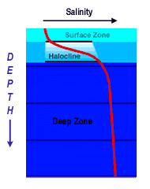
6. Salinity Profile (Variations with depth)
a/ Salinity increases
with depth.

Slide 13
Surface Zone: Less salt
Halocline: The vertical zone in the ocean column where salinity increases rapidly with depth.
Deep Zone: Greater salinity.

Slide 14
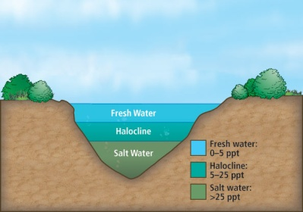
c/ Salinity influences ocean water layering.

Slide 15
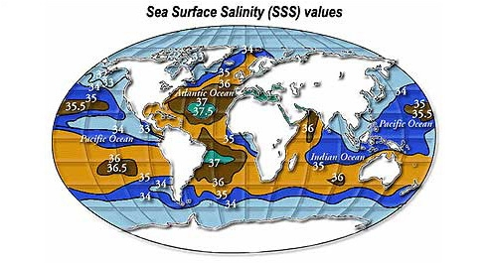
7. Sea Surface Salinity
Use diagram to describe variation in surface Salinity across Earth’s Oceans. Use Latitudes to help.
Equatorial ~0ºLat.?
22ºN and S Lat.?
Polar 60-90º N/S?
Mediterranean Sea?

Slide 17
7. Sea Surface Salinity
Equatorial ~0ºLat.? High 35.5-36
22ºN and S Lat.? Highest 36.5-37.5
Polar 60-90º N/S? Lowest 32-34
Mediterranean Sea? Highest 37.5-38.5

Slide 18
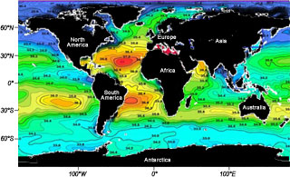

Slide 19
C. Temperature
1/ Ocean temperature varies with the amount of solar radiation received. The amount of solar radiation received depends on latitude, and depth.

Slide 20
2/ The temperature of the
surface layer varies
from 36ºF … 97ºF and
-2ºC … 28ºC.
3/ Sea water with an
average 35ppt salinity
freezes at -2ºC (28.5ºF).
4/ Average Temperature of
surface waters is 17ºC (63ºF).

Slide 21
5/ Surface waters are warmer at the equator and colder at the poles.
6/ Ocean waters are warmer near the surface and colder with depth.

Slide 22
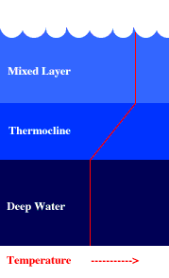
7. Temperature Layers
Mixed Layer: (surface) Solar radiation and mixing makes uniform temperature. Warmer.
Thermocline: Temperatures decreases rapidly. Acts as a barrier. 300-1000m deep.
Deep water: Very cold uniform temperature.

Slide 23
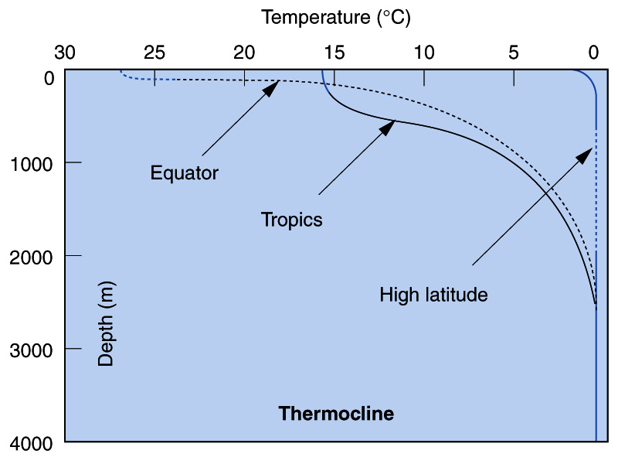
8. The Thermocline
a/ Changes with latitude:
1/ Deepest at the Equator.
2/ Shallowest or non-existant at higher latitudes.

Slide 25
The Deep Layer is very cold!
1/ 90% of all Ocean water lies beneath the thermocline.
2/ The deep ocean layer is not mixed well and consists of density layers.
3/ The deep layer is very cold all around the world 0-3ºC (32-37.5ºF).

Slide 26
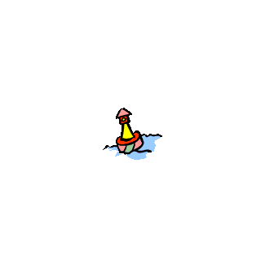
Argos
A system of hundreds of buoys at the surface descend deep and rise over time sending data to satellite giving us real time data on salinity and temperature in the layers of the sea.

Slide 27
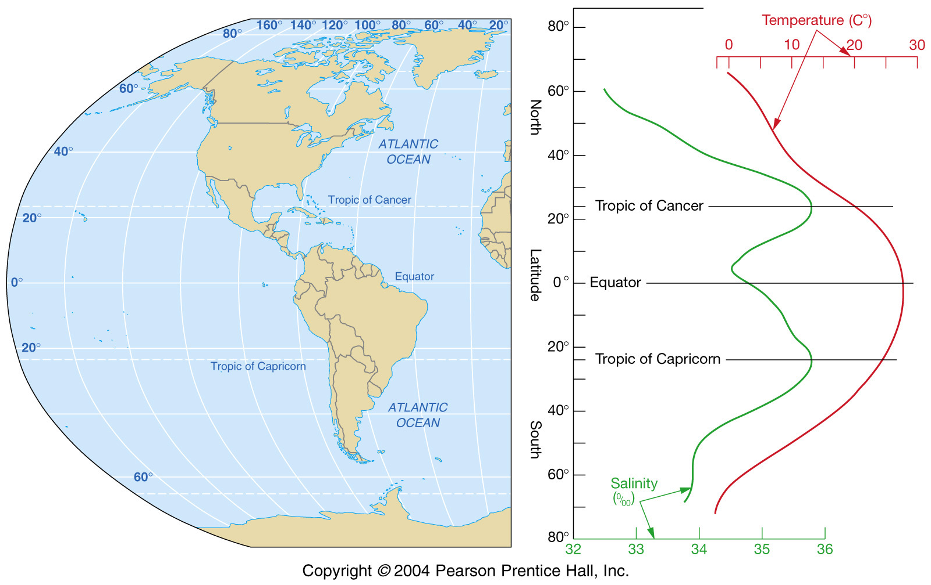
Melting Ice and rivers reduce salinity
High
60-90º Polar
Horse Latitudes: Sunny/Dry
23-30º N
0º Tropics
Doldrums: Rainy!!!!!
Low
23-30º S
Horse Latitudes: Sunny/Dry
High

Slide 28
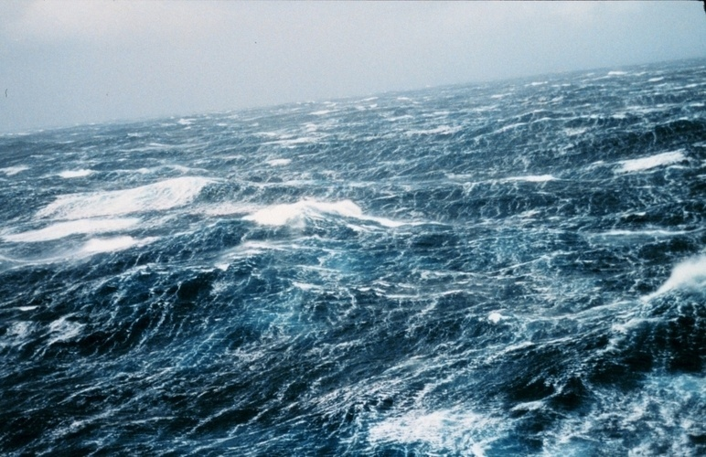
Density in the Ocean

Slide 29
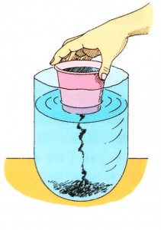
E. DENSITY of Ocean Water
1. Density = mass /volume How heavy for size.
2. Density of pure water is 1.0 g/cm³
3. The average density of ocean water is 1.027 g/cm³ It ranges from 1.02 to 1.03.
4. Denser ocean water sinks!
5. Ocean water density depends on:
salinity, temperature & pressure

Slide 30
6/ Density of water is mostly determined by temperature.
7/ Cold water sinks. Warm water rises.
8/ Density is also effected by salinity. Salty water is heavier … Sink!
Less saline water is lighter ... rises.

Slide 31
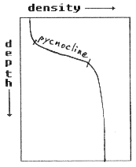
9/ Density Profiles
a/ Density increases with depth.
b/ Warmer, less salty water at surface and colder, saltier water in the Deep.
c/ The region of rapid density change is called the pycnocline. It acts as a barrier between Deep and surface waters. 300-1000m deep.

Slide 32
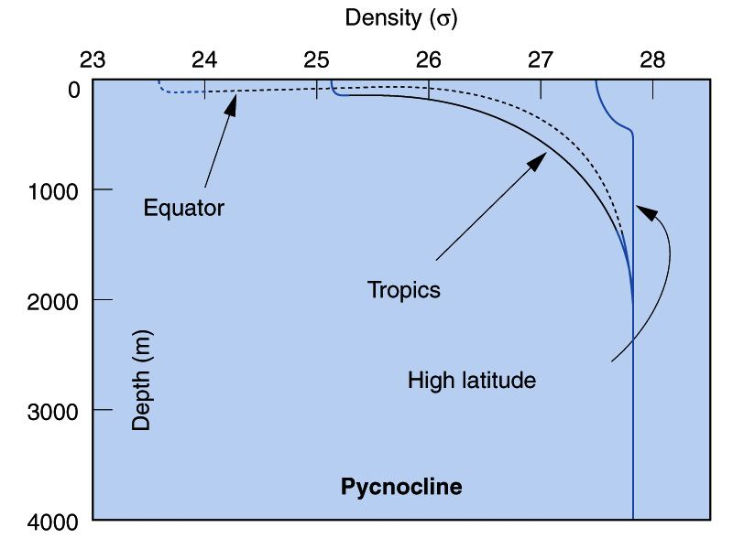
10/ Density in Polar Waters (High Latitudes)
a/ Cold, salty waters in the polar regions have little to no pycnocline. They start out dense and stay dense all the way down to the bottom.

Slide 33
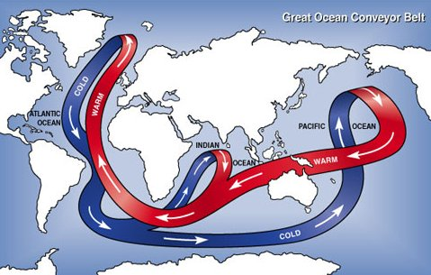
b/ These waters sink to the deep zone driving deep sea circulation! They bring oxygen nutrients down with them.
https://www.youtube.com/watch?v=FuOX23yXhZ8

