Slide 1
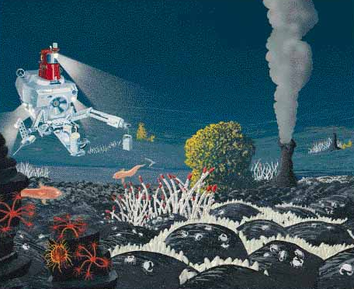
Deep Sea Sediments

Slide 2
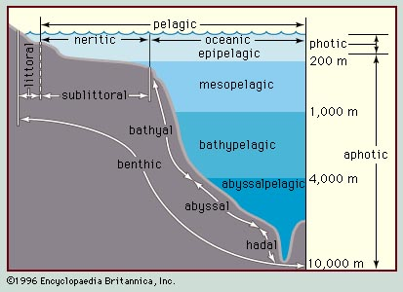
A. Ocean Zones
photic
100m
dysphotic
1. Litttoral Zones
aphotic
2. Neritic Zones
3. Pelagic Zones
4. Benthic Zones
5. Photic Zones
Notes:
Pelagic Habitats:
water column divided by depth, largely as a function of change in light penetration
epipelagic zone extends from the sea surface to a depth of ~200 meters
zone of constant illumination (euphotic zone)
characterized by photosynthetic activity
therefore low nutrient concentrations and elevated oxygen concentrations
mesopelagic zone underlies epipelagic zone and extends downward to 1,000 meters
also referred to as the disphotic or 'twilight' zone
extends below the photosynthetic zone
therefore exhibits reduced oxygen and increased nutrient concentrations
distinct oxygen minimum layer occurs within the mesopelagic zone
associated with the bacterial decomposition of sinking organic matter
bathypelagic zone (aphotic) extends from depths of ~1,000 meters to ~4,000 meters
underlain by abyssalpelagic zone (also aphotic) to a water depth of ~6,000 meters
O₂ concentration increases with depth in bathypelagic, abyssalpelagic zones
elevated levels of O₂ derived from sinking of cold, gas-rich waters of the poles
water depths over ~6,000 meters (deep-sea trenches) termed hadalpelagic

Slide 3
B. Terms to know referring to ocean zones:
1/ Neritic- “of the coast”; Coastal; Continental Shelf.
2/ Pelagic- “of the sea”; Marine;

Slide 4
C. Sources of Sediment
Terrigenous- “earth produced”
Biogenous- “life produced”
Hydrogenous- “water produced”
Cosmogenous- “universe produced”

Slide 5
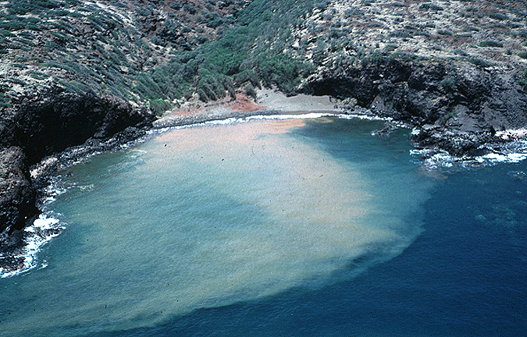
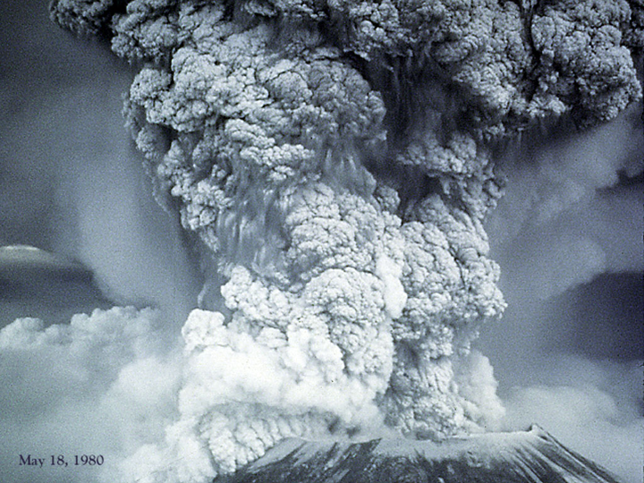
D. Terrigenous: “from land”.
Desert sand blows off continent to ocean
Volcanic eruptions- dust and magma
Rivers- sediments transported onto continental shelves
Mt. St. Helens
Notes:
Earth generated
Ex. Sahara desert
Mt Pinatubo (Philippians)
Mississippi and Amazon

Slide 6
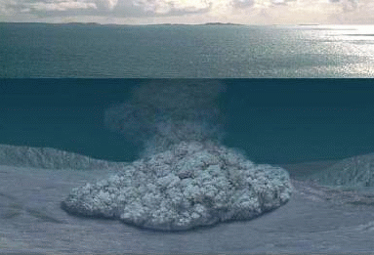
4. Turbidity Currents: Avalanches of muddy ocean waters made heavy by terrigenous sediments. They flow down continental slopes and submarine canyons forming continental rise. Sorted by size of sediments… gravel-sand-silt-clay.
https://www.youtube.com/watch?v=8gYJJjxY8g0

Slide 7
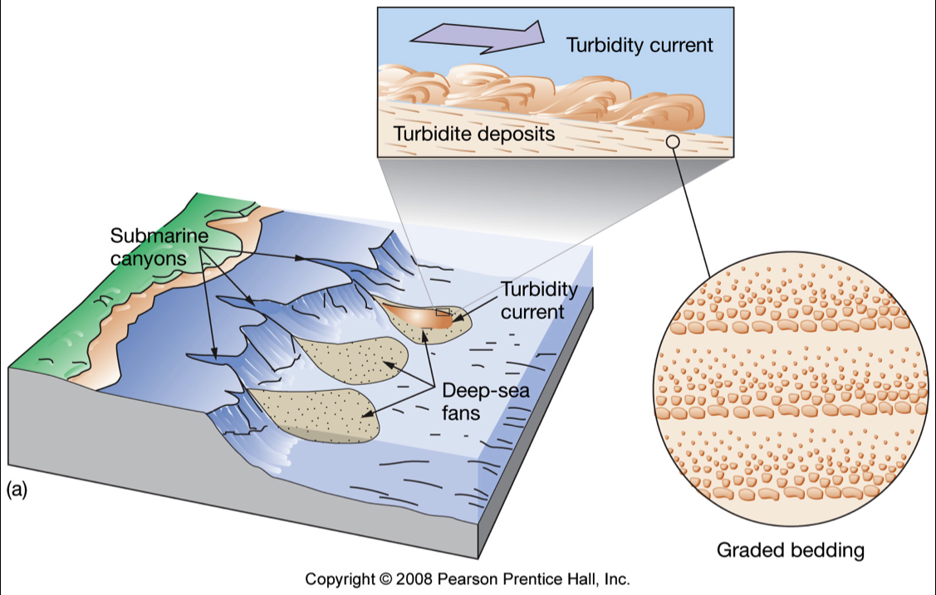

Slide 8
E. Pelagic Sediments:
Sediments that come from open ocean water, not from land. Form in deep seas far from land.
Atlantic: over 3,000 feet thick
Pacific: over 1,600 feet thick

Slide 9
E. Pelagic Sediments:
Oozes: Fine muds with >30% biological materials (pieces of living things).
Clays: fine dust size particles containing <30% biological materials. Besides clay, contains pieces of living things (marine snow CaCO₃ ), micrometeorites, and volcanic dust.

Slide 10
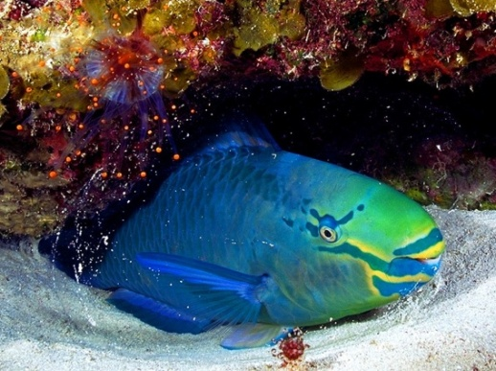
F. Biogenous: from living things.
Mostly calcareous CaCO₃ and siliceous SiO₃ from zooplankton(animal) and phytoplankton(plant)
Parrotfish: It crunches coral into white tropical sands…
to feed on algae
in dead coral.
https://www.youtube.com/watch?v=nOaJW5bXoBU
Notes:
Biogenous- extracted from seawater into marine organisms

Slide 11
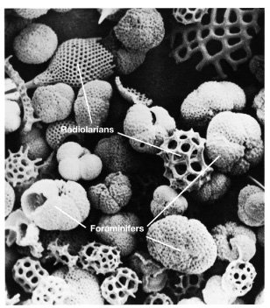
3/ Oozes: Pelagic(marine) sediments containing >30% microorganism shells.
4/ Two Types of Oozes:
1/ calcareous CaCO₃
2/ siliceous SiO₃
3/ Abundant where ample nutrients
encourage high biological productivity
of plankton (zoo, phyto).

Slide 12
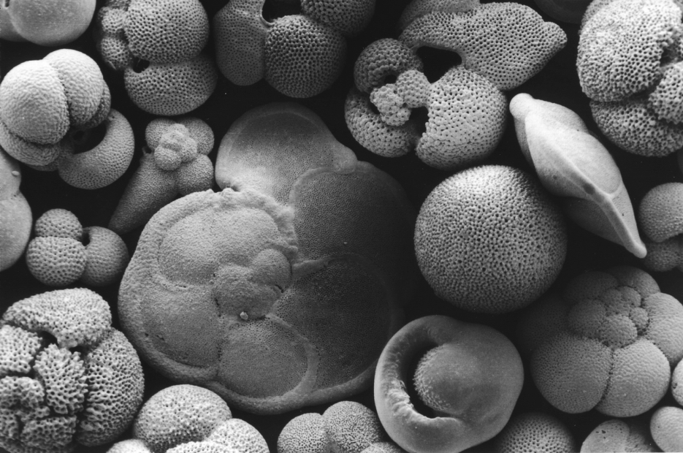
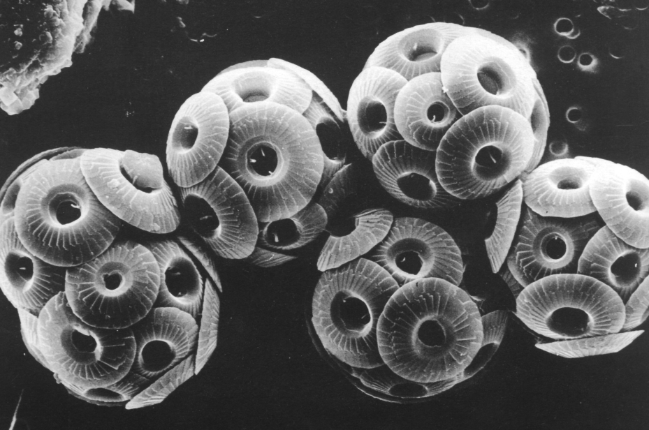
5/Calcareous Oozes: Calcium carbonate or calcite (CaCO₃)
2. Foraminifers
(zooplankton-protozoa)
1. Coccolithophores
(phytoplankton-algae)
Chalk- Rock made of coccolith rich sediments. White Cliffs of Dover in England.
3. Dissolve in deepest waters! Below CCD (CaCO3 composition depth)… acidic.

Slide 13
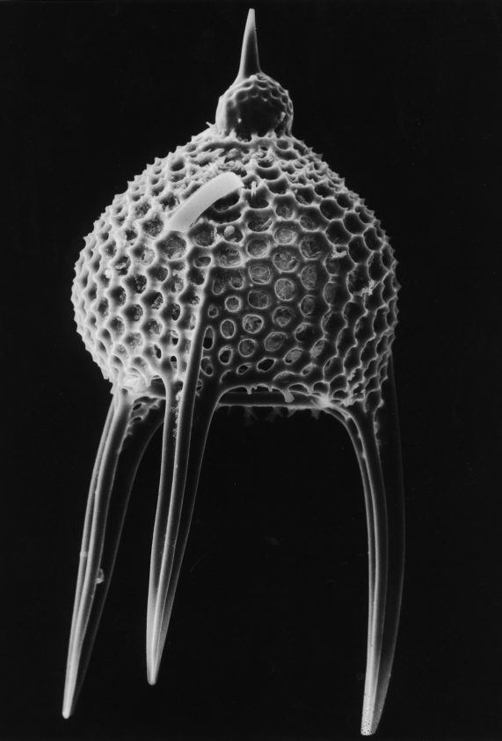
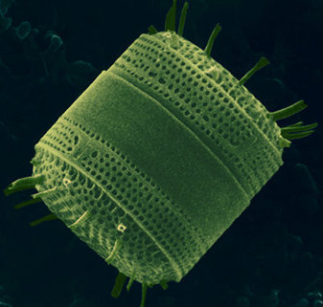
6/ Siliceous Oozes: (SiO₂) glassy
2. Diatom- phytoplankton
1. radiolarian- zooplankton
4. Diatomaceous earth- sediment made up of mostly diatoms. Uses: filter systems, toothpaste, and paints.
3. Concentrated in deepest waters! Do not dissolve below CCD…not CaCO₃!

Slide 14
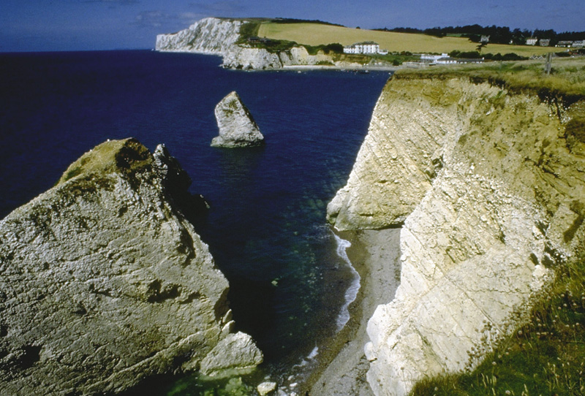
7/ Biogenous ooze turns to rock
When biogenous ooze hardens and lithifies, it can form:
Diatomaceous earth (if composed of diatom-rich ooze)
Chalk (if composed of coccolith-rich ooze)
Fossiliferous limestone
d. White Cliffs of Dover in southern England

Slide 15
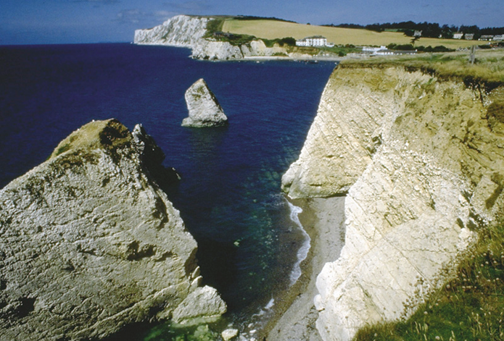
d. White Cliffs of Dover in southern England

Slide 16
8/ Distribution of biogenous ooze
Most biogenous ooze found as pelagic deposits at the bottom of the open ocean.
Factors affecting the distribution of biogenous ooze:
Productivity (amount of organisms in surface waters)
Destruction (dissolving at depth)
Dilution (mixing with lithogenous clays)

Slide 17
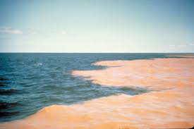
G. Red Clays
Red or brown sediment with less than 30% biogenic material.
Form in the deepest calmest areas of the ocean.
Tiny particles take 100 years to descend.
No CaCO₃. It dissolves at great depths! Below CCD.
It accumulates very slowly 0.2 cm/1000 years

Slide 19
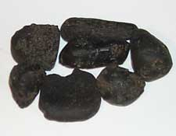
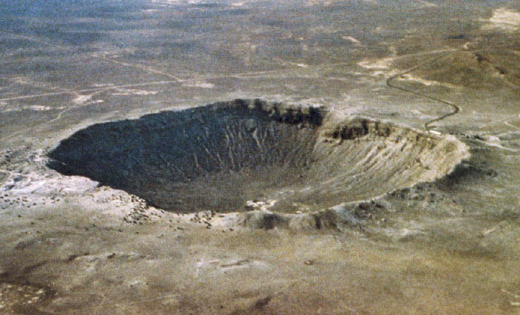
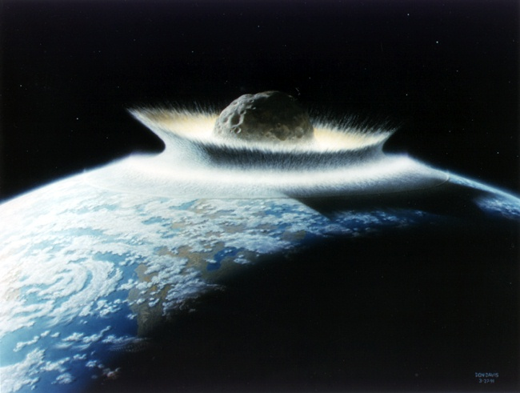
H. Cosmogenous sediments:
tektites
Extraterrestrial in origin
Two main types:
Microscopic space dust
Macroscopic meteor debris
3. Forms an insignificant proportion of
ocean sediment
Notes:
Interplanetary dust- tektites and glassy nodules
?65 mya asteroid impacted with the earth- possibly associated with dinosaur estinction
High deposits of iridium at the K-T boundary layer

Slide 20
I. Hydrogenous sediment
Form when dissolved materials come out of solution as precipitates or evaporates.
Precipitation is caused by a change in conditions including:
Changes in temperature (evaporation)
Changes in pressure
Addition of chemically active fluids
(like CO₂)

Slide 21
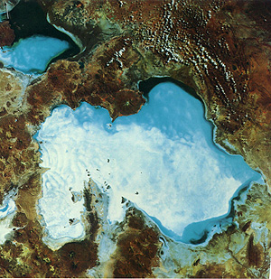
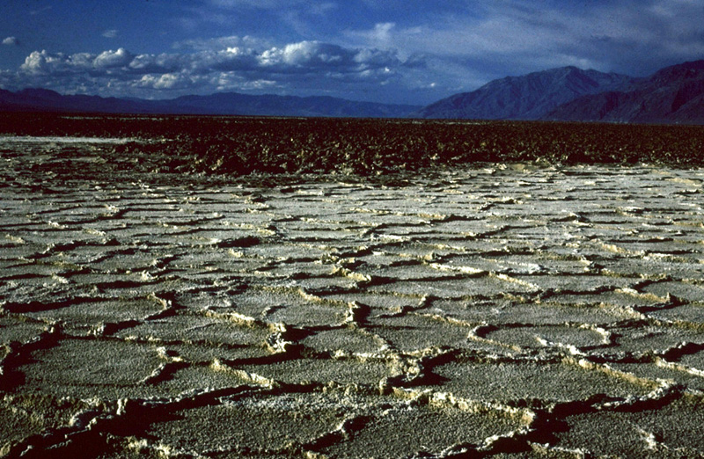
3/ Types of hydrogenous sediment:
Manganese nodules
Phosphates
Carbonates
Metal sulfides
Evaporite salts

Slide 22
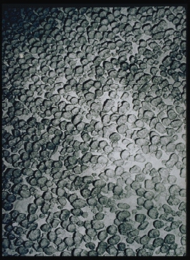
4. Manganese nodules: A treasure chest!
1st discovered by Challenger expedition (1873)
16 million tons accumulate each year
Growth rate: 1-10 mm every million years

Slide 23
4. Manganese nodules: A treasure chest!
Potato to beachball size- grow from nucleii of bone or teeth.
Manganese and iron oxides. Also, Co, Cr, Ni, Cu, Mb, and Zn.

Slide 24
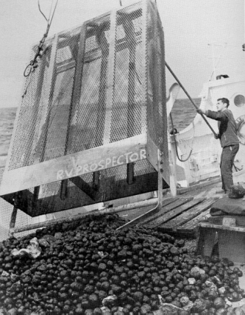
6. Mining has not developed because:
Metal prices are not high enough
Legal issues
Technical issues
Environmental issues

Slide 25
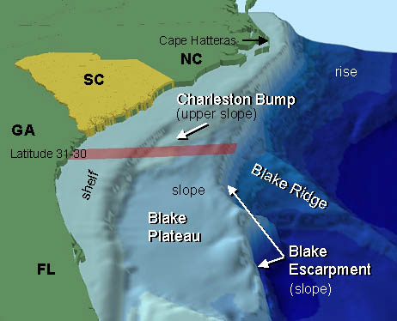
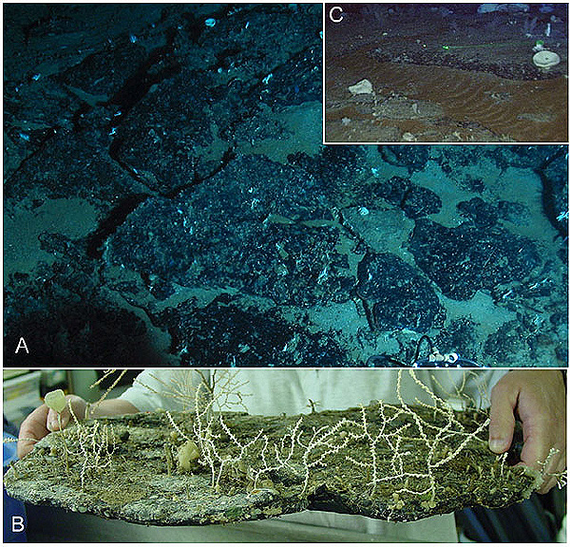
The Blake Terrace and Manganese and phosphate pavement.
A rich source of metal deposits above abyssal depths due to Gulf Stream Current preventing sediment accumulations.

Slide 26
https://www.youtube.com/watch?v=byu_X4Gcmcc

Slide 27
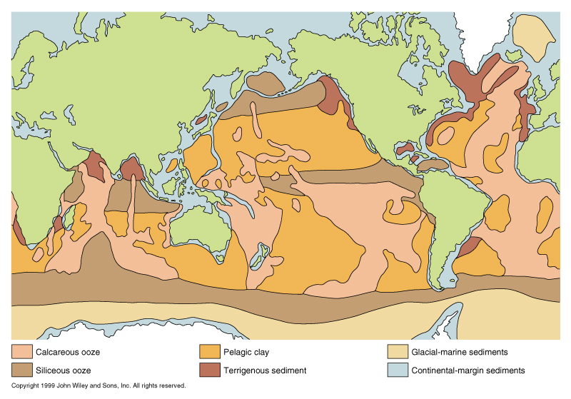
Map of the World Ocean showing generalized distribution of the principal kinds of sediment on the ocean floor

Slide 28
Summary of Sediment Map:
Red Clays occur in the deepest calmest parts of the ocean with low productivity.
Siliceous oozes occur in the deep oceans below CCD in areas with high productivity.
Calcareous oozes occur in areas of ocean with high productivity and above CCD level like plateaus, seamounts, m-o ridges.
Terrigenous sediments occur closer to continents along continental margins.
Manganeses nodules occur on abyssal plains and some plateaus (Blake).

Slide 29
Deep Ocean Characteristics
Cold
Still
Stable
Dark
Essentially no productivity
Sparse Life
Extremely high pressure
Little food
Calcium and oxygen ‘starved’

