Slide 1
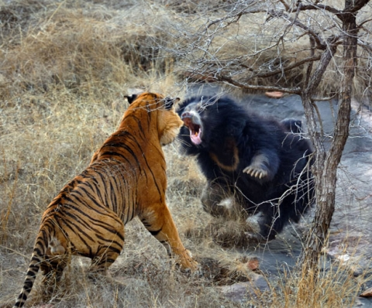
March Mammal Madness 2019!

Slide 2
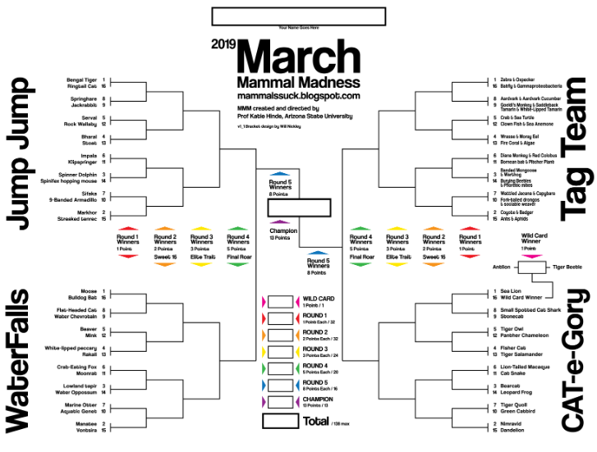
Twitter:
#2019MMM
@2019MMMletsgo
March Mammal Madness Facebook Page

Slide 3
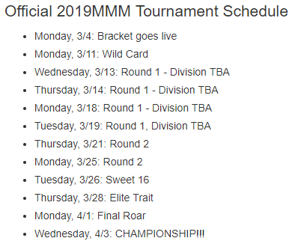
Tournament begins March 11! Tournament play begins each night at 7:00 pm CST
​​

Slide 4
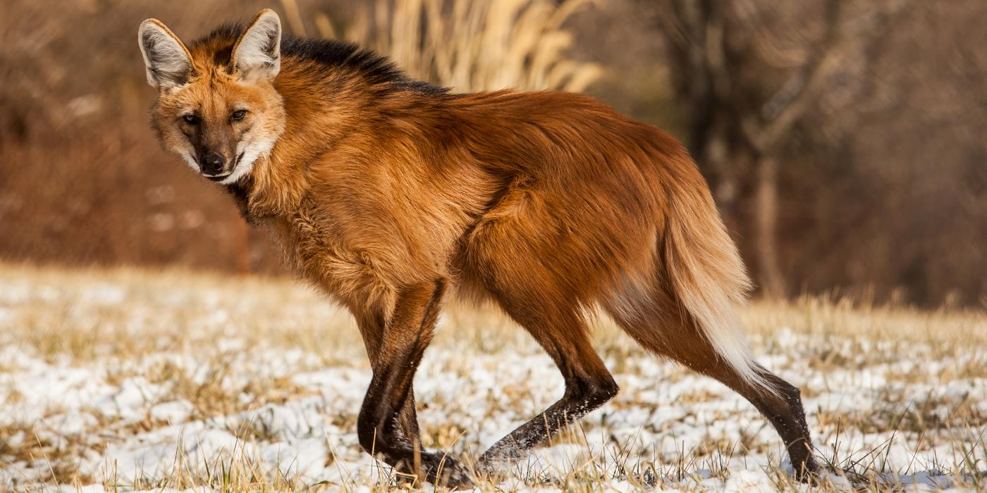
Tag Team (name of division)
Seed: 3
Maned Wolf
Example!!
Habitat/Biome: ex: Rainforest
Diet: herbivore, carnivore, omnivore?
Trophic Level: primary, secondary or tertiary consumer?
Structural Adaptation: name 1 structural adaptation the animal has that is a strength (structural adaptations = weaponry, armor, camouflage, nutrition, respiration, transport and excretion mechanisms, movement)
Fun Fact: something that might help them in battle, other adaptations? Interesting thing about how they live?

Slide 5
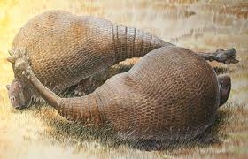
Jump Jump
Seed:
Bengal Tiger
Habitat/Biome:
Diet -
Trophic Level -
Structural Adaptation -
Photo
Photo
Fun Fact -

Slide 6
Jump Jump
Seed:
Ringtail Cat
Habitat/Biome:
Diet -
Trophic Level -
Structural Adaptation -
Photo
Photo
Fun Fact -

Slide 7
Jump Jump
Seed:
Springhare
Habitat/Biome:
Diet -
Trophic Level -
Structural Adaptation -
Photo
Photo
Fun Fact -

Slide 8
Jump Jump
Seed:
Jackrabbit
Habitat/Biome:
Diet -
Trophic Level -
Structural Adaptation -
Photo
Photo
Fun Fact -

Slide 9
Jump Jump
Seed:
Serval
Habitat/Biome:
Diet -
Trophic Level -
Structural Adaptation -
Photo
Photo
Fun Fact -

Slide 10
Jump Jump
Seed:
Rock Wallaby
Habitat/Biome:
Diet -
Trophic Level -
Structural Adaptation -
Photo
Photo
Fun Fact -

Slide 11
Jump Jump
Seed:
Bharal
Habitat/Biome:
Diet -
Trophic Level -
Structural Adaptation -
Photo
Photo
Fun Fact -

Slide 12
Jump Jump
Seed:
Stoat
Habitat/Biome:
Diet -
Trophic Level -
Structural Adaptation -
Photo
Photo
Fun Fact -

Slide 13
Jump Jump
Seed:
Impala
Habitat/Biome:
Diet -
Trophic Level -
Structural Adaptation -
Photo
Photo
Fun Fact -

Slide 14
Jump Jump
Seed:
Klipspringer
Habitat/Biome:
Diet -
Trophic Level -
Structural Adaptation -
Photo
Photo
Fun Fact -

Slide 15
Jump Jump
Seed:
Spinner Dolphin
Habitat/Biome:
Diet -
Trophic Level -
Structural Adaptation -
Photo
Photo
Fun Fact -

Slide 16
Jump Jump
Seed:
Spinifex hopping mouse
Habitat/Biome:
Diet -
Trophic Level -
Structural Adaptation -
Photo
Photo
Fun Fact -

Slide 17
Jump Jump
Seed:
Sifaka
Habitat/Biome:
Diet -
Trophic Level -
Structural Adaptation -
Photo
Photo
Fun Fact -

Slide 18
Jump Jump
Seed:
9-Banded Armadillo
Habitat/Biome:
Diet -
Trophic Level -
Structural Adaptation -
Photo
Photo
Fun Fact -

Slide 19
Jump Jump
Seed:
Markhor
Habitat/Biome:
Diet -
Trophic Level -
Structural Adaptation -
Photo
Photo
Fun Fact -

Slide 20
Jump Jump
Seed:
Streaked tenrec
Habitat/Biome:
Diet -
Trophic Level -
Structural Adaptation -
Photo
Photo
Fun Fact -

Slide 21
Waterfalls
Seed:
Moose
Habitat/Biome: -
Diet -
Trophic Level -
Structural Adaptation -
Photo
Photo
Fun Fact -

Slide 22
Waterfalls
Seed:
Bulldog Bat
Habitat/Biome: -
Diet -
Trophic Level -
Structural Adaptation -
Photo
Photo
Fun Fact -

Slide 23
Waterfalls
Seed:
Flat-Headed Cat
Habitat/Biome: -
Diet -
Trophic Level -
Structural Adaptation -
Photo
Photo
Fun Fact -

Slide 24
Waterfalls
Seed:
Water Chevrotain
Habitat/Biome: -
Diet -
Trophic Level -
Structural Adaptation -
Photo
Photo
Fun Fact -

Slide 25
Waterfalls
Seed:
Beaver
Habitat/Biome: -
Diet -
Trophic Level -
Structural Adaptation -
Photo
Photo
Fun Fact -

Slide 26
Waterfalls
Seed:
Mink
Habitat/Biome: -
Diet -
Trophic Level -
Structural Adaptation -
Photo
Photo
Fun Fact -

Slide 27
Waterfalls
Seed:
White-lipped peccary
Habitat/Biome: -
Diet -
Trophic Level -
Structural Adaptation -
Photo
Photo
Fun Fact -

Slide 28
Waterfalls
Seed:
Rakali
Habitat/Biome: -
Diet -
Trophic Level -
Structural Adaptation -
Photo
Photo
Fun Fact -

Slide 29
Waterfalls
Seed:
Crab-Eating Fox
Habitat/Biome: -
Diet -
Trophic Level -
Structural Adaptation -
Photo
Photo
Fun Fact -

Slide 30
Waterfalls
Seed:
Moonrat
Habitat/Biome: -
Diet -
Trophic Level -
Structural Adaptation -
Photo
Photo
Fun Fact -

Slide 31
Waterfalls
Seed:
Lowland tapir
Habitat/Biome: -
Diet -
Trophic Level -
Structural Adaptation -
Photo
Photo
Fun Fact -

Slide 32
Waterfalls
Seed:
Water Opossum
Habitat/Biome: -
Diet -
Trophic Level -
Structural Adaptation -
Photo
Photo
Fun Fact -

Slide 33
Waterfalls
Seed:
Marine Otter
Habitat/Biome: -
Diet -
Trophic Level -
Structural Adaptation -
Photo
Photo
Fun Fact -

Slide 34
Waterfalls
Seed:
Aquatic Genet
Habitat/Biome: -
Diet -
Trophic Level -
Structural Adaptation -
Photo
Photo
Fun Fact -

Slide 35
Waterfalls
Seed:
Manatee
Habitat/Biome: -
Diet -
Trophic Level -
Structural Adaptation -
Photo
Photo
Fun Fact -

Slide 36
Waterfalls
Seed:
Vontsira
Habitat/Biome: -
Diet -
Trophic Level -
Structural Adaptation -
Photo
Photo
Fun Fact -

Slide 37
Tag Team
Seed:
Zebra & Oxpecker
Habitat/Biome: -
Diet -
Trophic Level -
Structural Adaptation -
Photo
Photo
Fun Fact -

Slide 38
Tag Team
Seed:
Batfly & Gammaproteobacteria
Habitat/Biome: -
Diet -
Trophic Level -
Structural Adaptation -
Photo
Photo
Fun Fact -

Slide 39
Tag Team
Seed:
Aardvark & Aardvark Cucumber
Habitat/Biome: -
Diet -
Trophic Level -
Structural Adaptation -
Photo
Photo
Fun Fact -

Slide 40
Tag Team
Seed:
Goeldi’s Monkey & Saddleback Tamarin & White-lipped Tamarin
Habitat/Biome: -
Diet -
Trophic Level -
Structural Adaptation -
Photo
Photo
Fun Fact -

Slide 41
Tag Team
Seed:
Crab & Sea Turtle
Habitat/Biome: -
Diet -
Trophic Level -
Structural Adaptation -
Photo
Photo
Fun Fact -

Slide 42
Tag Team
Seed:
Clown Fish & Sea Anemone
Habitat/Biome: -
Diet -
Trophic Level -
Structural Adaptation -
Photo
Photo
Fun Fact -

Slide 43
Tag Team
Seed:
Wrasse & Moray Eel
Habitat/Biome: -
Diet -
Trophic Level -
Structural Adaptation -
Photo
Photo
Fun Fact -

Slide 44
Tag Team
Seed:
Fire Coral & Algae
Habitat/Biome: -
Diet -
Trophic Level -
Structural Adaptation -
Photo
Photo
Fun Fact -

Slide 45
Tag Team
Seed:
Diana Monkey & Red Colobus
Habitat/Biome: -
Diet -
Trophic Level -
Structural Adaptation -
Photo
Photo
Fun Fact -

Slide 46
Tag Team
Seed:
Bornean bat & Pitcher Plant
Habitat/Biome: -
Diet -
Trophic Level -
Structural Adaptation -
Photo
Photo
Fun Fact -

Slide 47
Tag Team
Seed:
Banded Mongoose & Warthog
Habitat/Biome: -
Diet -
Trophic Level -
Structural Adaptation -
Photo
Photo
Fun Fact -

Slide 48
Tag Team
Seed:
Burying Beetles & Phoretic Mites
Habitat/Biome: -
Diet -
Trophic Level -
Structural Adaptation -
Photo
Photo
Fun Fact -

Slide 49
Tag Team
Seed:
Wattled Jacana & Capybara
Habitat/Biome: -
Diet -
Trophic Level -
Structural Adaptation -
Photo
Photo
Fun Fact -

Slide 50
Tag Team
Seed:
Fork-tailed drongos & sociable weaver
Habitat/Biome: -
Diet -
Trophic Level -
Structural Adaptation -
Photo
Photo
Fun Fact -

Slide 51
Tag Team
Seed:
Coyote & Badger
Habitat/Biome: -
Diet -
Trophic Level -
Structural Adaptation -
Photo
Photo
Fun Fact -

Slide 52
Tag Team
Seed:
Ant & Aphids
Habitat/Biome: -
Diet -
Trophic Level -
Structural Adaptation -
Photo
Photo
Fun Fact -

Slide 53
CAT-e-gory
Wildcard
Antlion
Habitat/Biome: -
Diet -
Trophic Level -
Structural Adaptation -
Photo
Photo
Fun Fact -

Slide 54
CAT-e-gory
Wildcard
Tiger Beetle
Habitat/Biome: -
Diet -
Trophic Level -
Structural Adaptation -
Photo
Photo
Fun Fact -

Slide 55
CAT-e-gory
Seed:
Sea Lion
Habitat/Biome: -
Diet -
Trophic Level -
Structural Adaptation -
Photo
Photo
Fun Fact -

Slide 56
CAT-e-gory
Seed:
Small Spotted Cat Shark
Habitat/Biome: -
Diet -
Trophic Level -
Structural Adaptation -
Photo
Photo
Fun Fact -

Slide 57
CAT-e-gory
Seed:
Stonecat
Habitat/Biome: -
Diet -
Trophic Level -
Structural Adaptation -
Photo
Photo
Fun Fact -

Slide 58
CAT-e-gory
Seed:
Tiger owl
Habitat/Biome: -
Diet -
Trophic Level -
Structural Adaptation -
Photo
Photo
Fun Fact -

Slide 59
CAT-e-gory
Seed:
Panther Cameleon
Habitat/Biome: -
Diet -
Trophic Level -
Structural Adaptation -
Photo
Photo
Fun Fact -

Slide 60
CAT-e-gory
Seed:
Fisher Cat
Habitat/Biome: -
Diet -
Trophic Level -
Structural Adaptation -
Photo
Photo
Fun Fact -

Slide 61
CAT-e-gory
Seed:
Tiger Salamander
Habitat/Biome: -
Diet -
Trophic Level -
Structural Adaptation -
Photo
Photo
Fun Fact -

Slide 62
CAT-e-gory
Seed:
Lion-Tailed Macaque
Habitat/Biome: -
Diet -
Trophic Level -
Structural Adaptation -
Photo
Photo
Fun Fact -

Slide 63
CAT-e-gory
Seed:
Cat Snake
Habitat/Biome: -
Diet -
Trophic Level -
Structural Adaptation -
Photo
Photo
Fun Fact -

Slide 64
CAT-e-gory
Seed:
Bearcat
Habitat/Biome: -
Diet -
Trophic Level -
Structural Adaptation -
Photo
Photo
Fun Fact -

Slide 65
CAT-e-gory
Seed:
Leopard Frog
Habitat/Biome: -
Diet -
Trophic Level -
Structural Adaptation -
Photo
Photo
Fun Fact -

Slide 66
CAT-e-gory
Seed:
Tiger Quoll
Habitat/Biome: -
Diet -
Trophic Level -
Structural Adaptation -
Photo
Photo
Fun Fact -

Slide 67
CAT-e-gory
Seed:
Green Catbird
Habitat/Biome: -
Diet -
Trophic Level -
Structural Adaptation -
Photo
Photo
Fun Fact -

Slide 68
CAT-e-gory
Seed:
Nimravid
Habitat/Biome: -
Diet -
Trophic Level -
Structural Adaptation -
Photo
Photo
Fun Fact -

Slide 69
CAT-e-gory
Seed:
Dandelion
Habitat/Biome: -
Diet -
Trophic Level -
Structural Adaptation -
Photo
Photo
Fun Fact -

