Slide 1
March Mammal Madness 2019
Compiled by Heather Earp
West Johnston High School
Benson, North Carolina
Twitter: @MsEarpWJHS
Created by Katie Hinde
[Arizona State University]

Slide 2
Are you ready??
Show me your bracket!
Email it to Heatherearp@johnston.k12.nc.us
I’ll post some in this presentation!
Click Here for the MMM Blog/Homepage
Click Here for the ASU Libguide

Slide 3
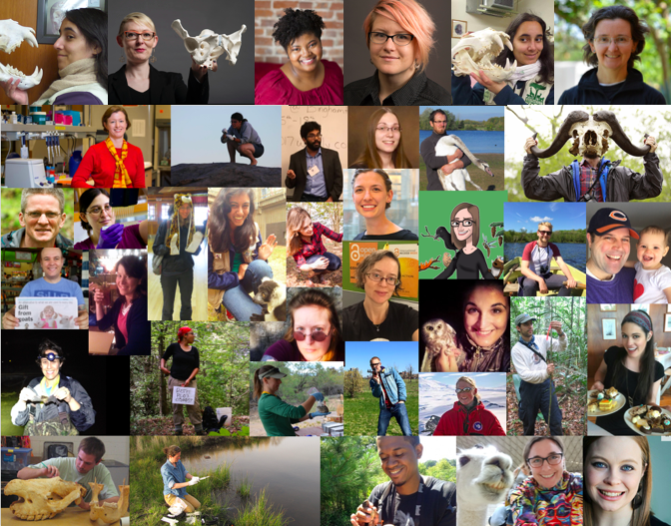
Meet the
MMM Team!

Slide 4
Want to be in the know? Follow on Twitter:
@2019MMMletsgo ‏
@Mammals_Suck
@c_n_anderson ‏
@Drew_Lab ‏
Use the Hashtag
#2019MMM
Check out Katie’s Blog!!

Slide 5
Be sure to check out the Official MMM Page!
From the Creators of MMM!!
The Schedule:
Monday, 3/11: Wild Card
Wednesday, 3/13: Round 1 - Division TBA
Thursday, 3/14: Round 1 - Division TBA
Monday, 3/18: Round 1 - Division TBA
Tuesday, 3/19: Round 1, Division TBA
Check out the Scientific Names as well!!
Thursday, 3/21: Round 2
Monday, 3/25: Round 2
Tuesday, 3/26: Sweet 16
Thursday, 3/28: Elite Trait
Monday, 4/1: Final Roar
Wednesday, 4/3: CHAMPIONSHIP!!!

Slide 6
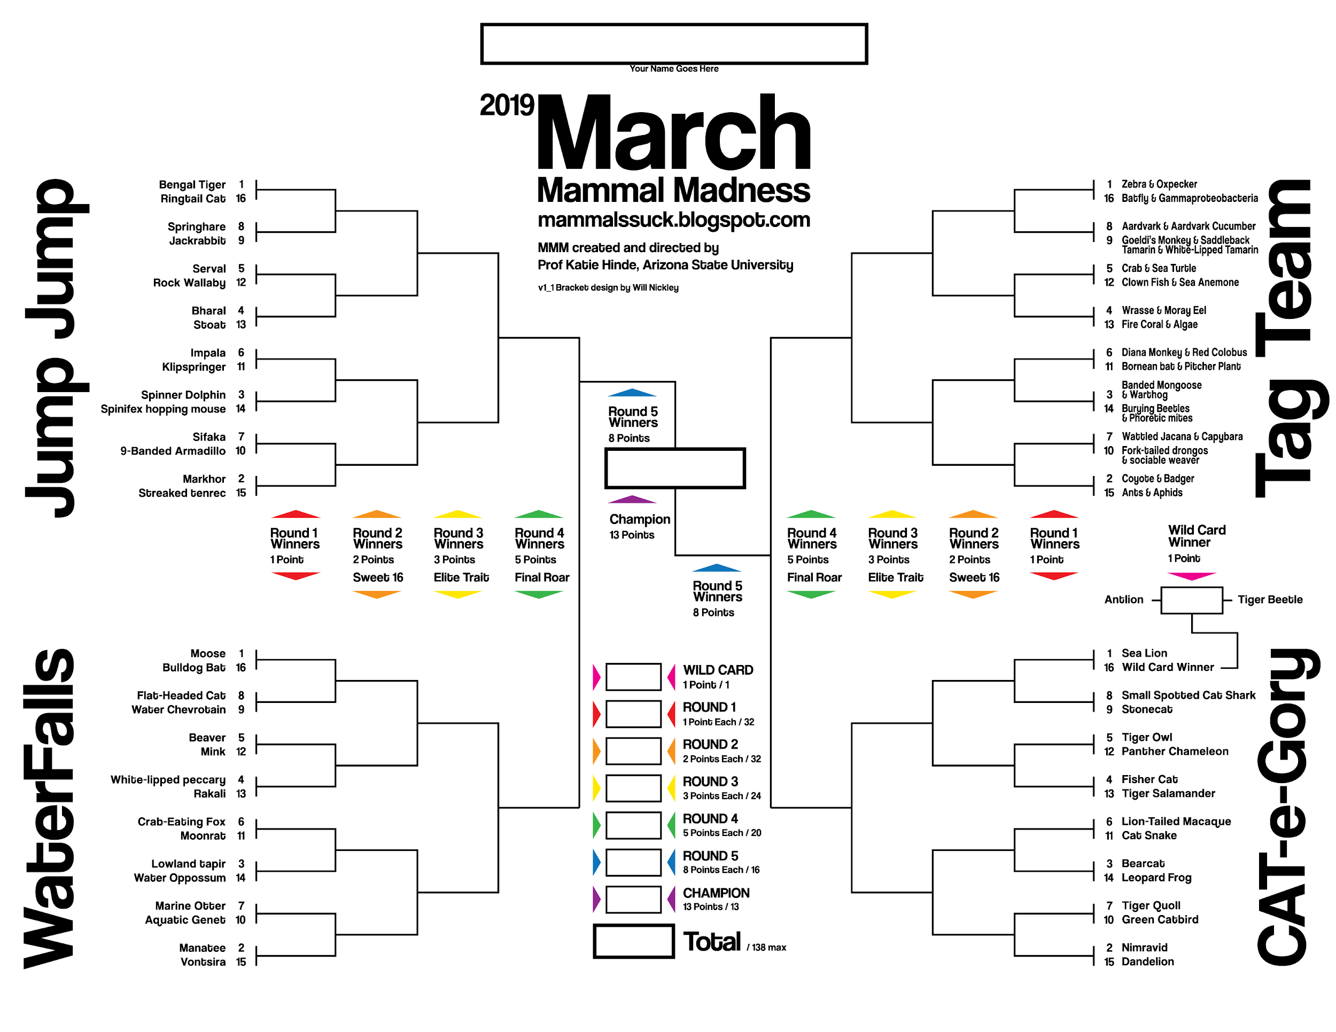

Slide 7
Round One!

Slide 9
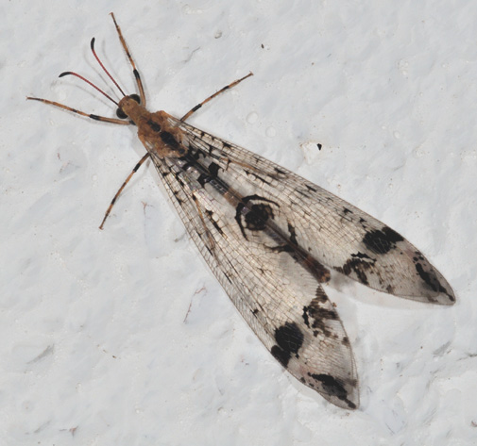
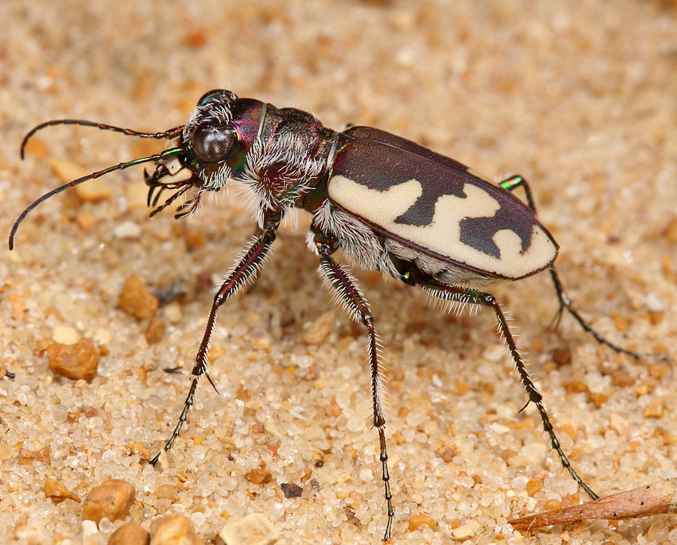
Antlion
Tiger Beetle
Image Link
Image Link

Slide 10
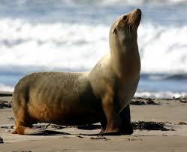
1- Sea Lion
16- Wild Card Winner
CAT-e-gory
Image Link
Image Link

Slide 11
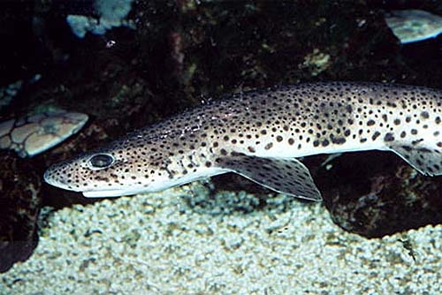
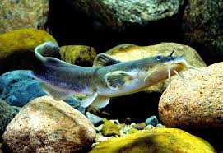
8- Small Spotted Cat Shark
9- Stonecat
CAT-e-gory
Image Link
Image Link

Slide 12
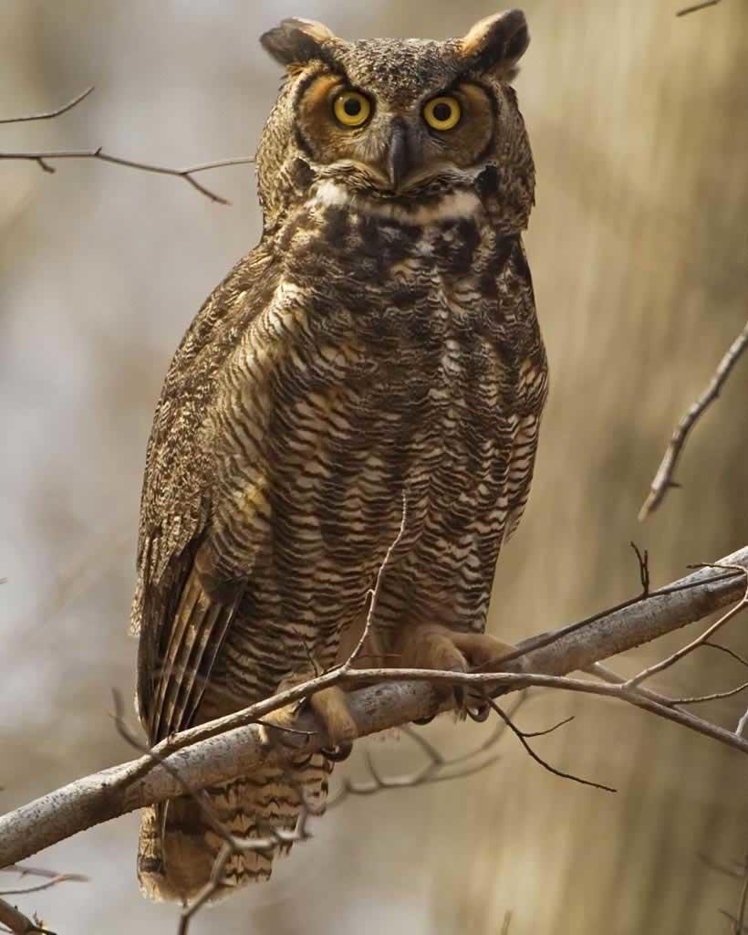
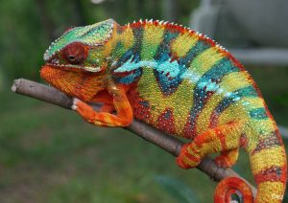
5- Tiger Owl
12- Panther Chameleon
CAT-e-gory
Image Link
Image Link

Slide 13
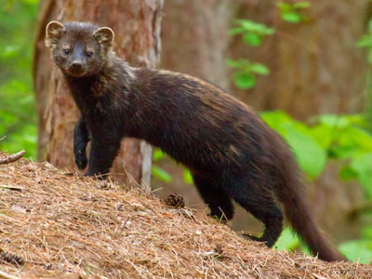
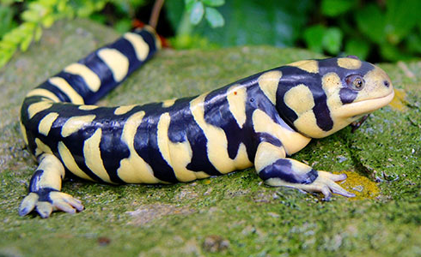
4- Fisher Cat
13- Tiger Salamander
CAT-e-gory
Image Link
Image Link

Slide 14
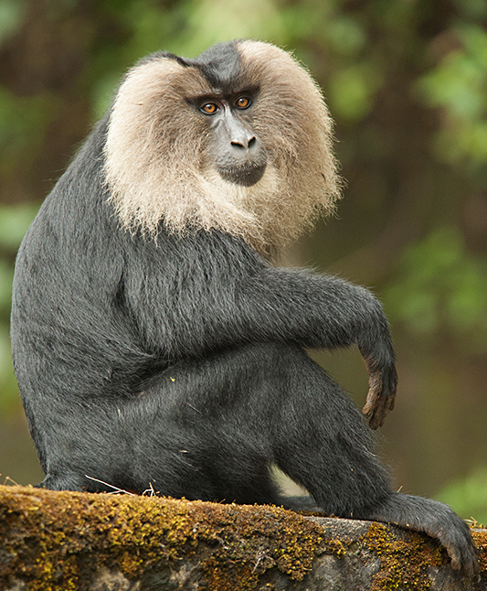
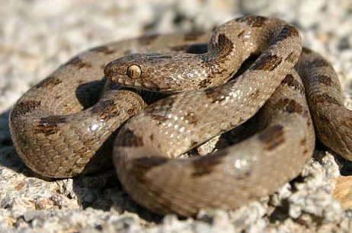
6- Lion-Tailed Macaque
11- Cat Snake
CAT-e-gory
Image Link
Image Link

Slide 15
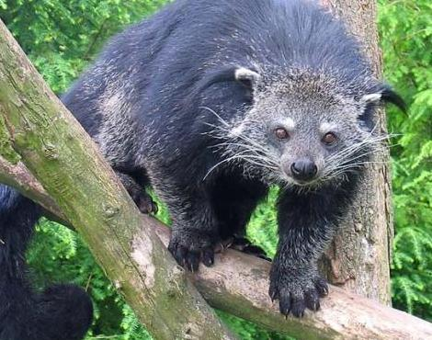
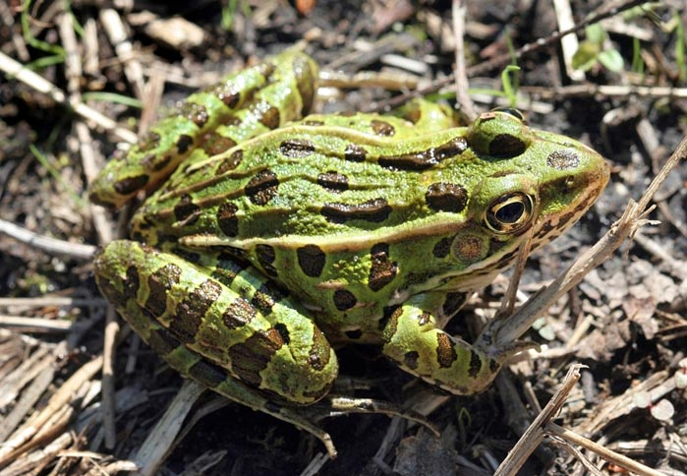
3- Bearcat
14- Leopard Frog
CAT-e-gory
Image Link
Image Link

Slide 16
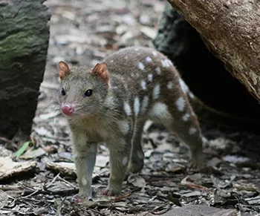
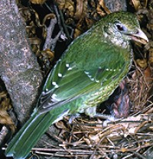
7- Tiger Quoll
10- Green Catbird
CAT-e-gory
Image Link
Image Link

Slide 17
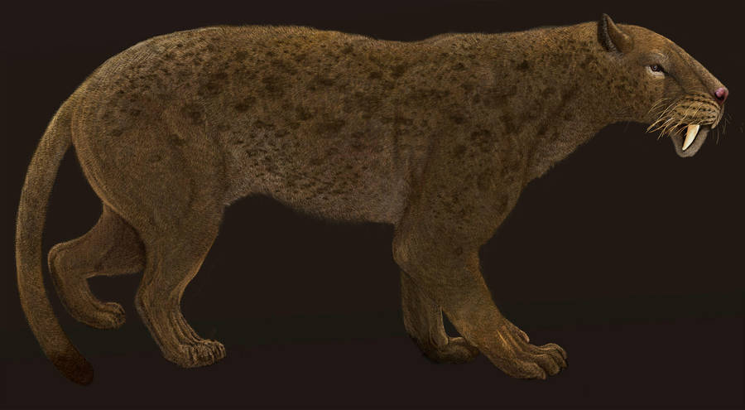
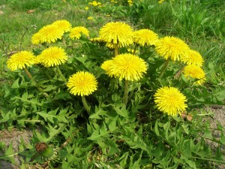
2- Nimravid
15- Dandelion
CAT-e-gory
Image Link
Image Link

Slide 19
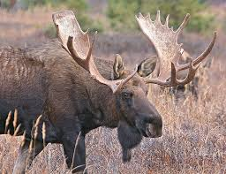
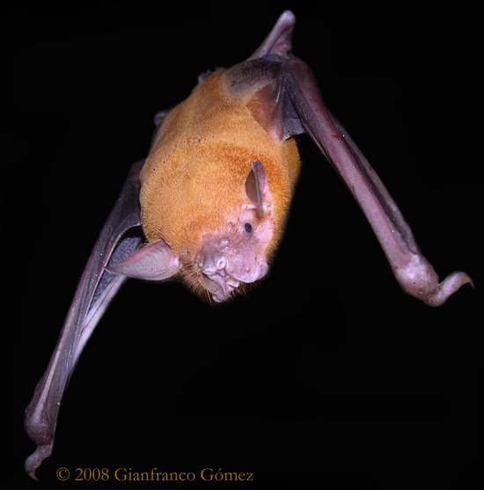
1- Moose
16- Bulldog Bat
WaterFalls
Image Link
Image Link

Slide 20
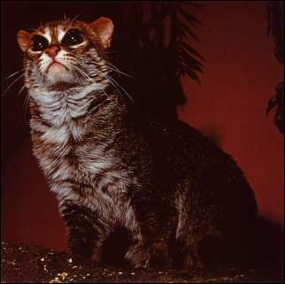
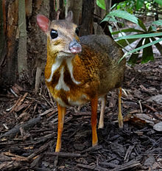
8- Flat-headed Cat
9- Water Chevrotain
WaterFalls
Image Link
Image Link

Slide 21
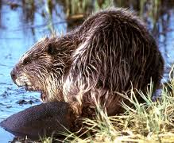
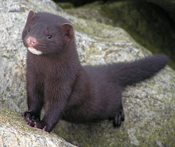
5- Beaver
12- Mink
WaterFalls
Image Link
Image Link

Slide 22
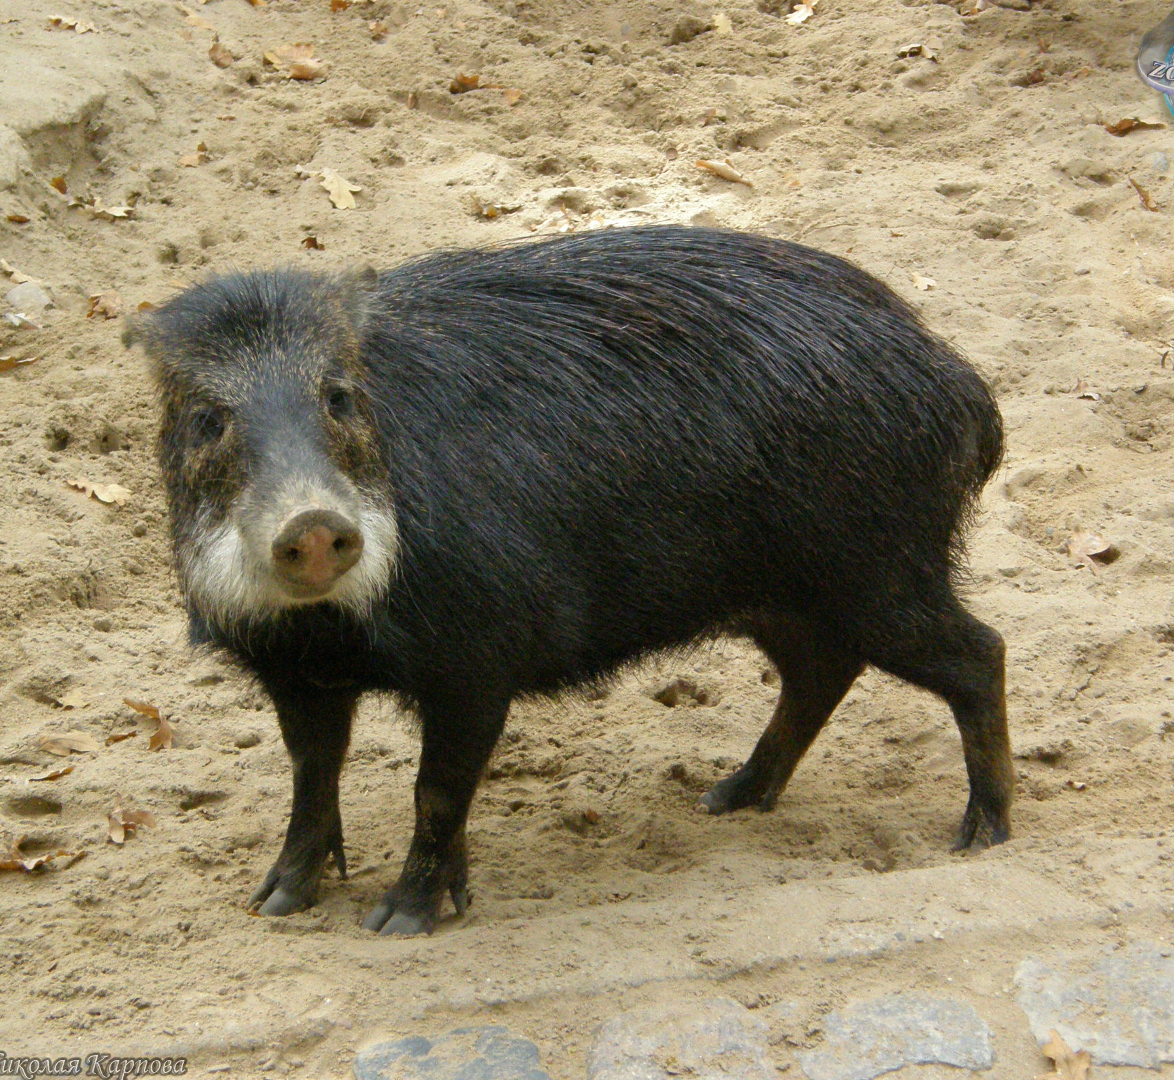
4- White-lipped Peccary
14- Rakali
WaterFalls
Image Link
Image Link

Slide 23
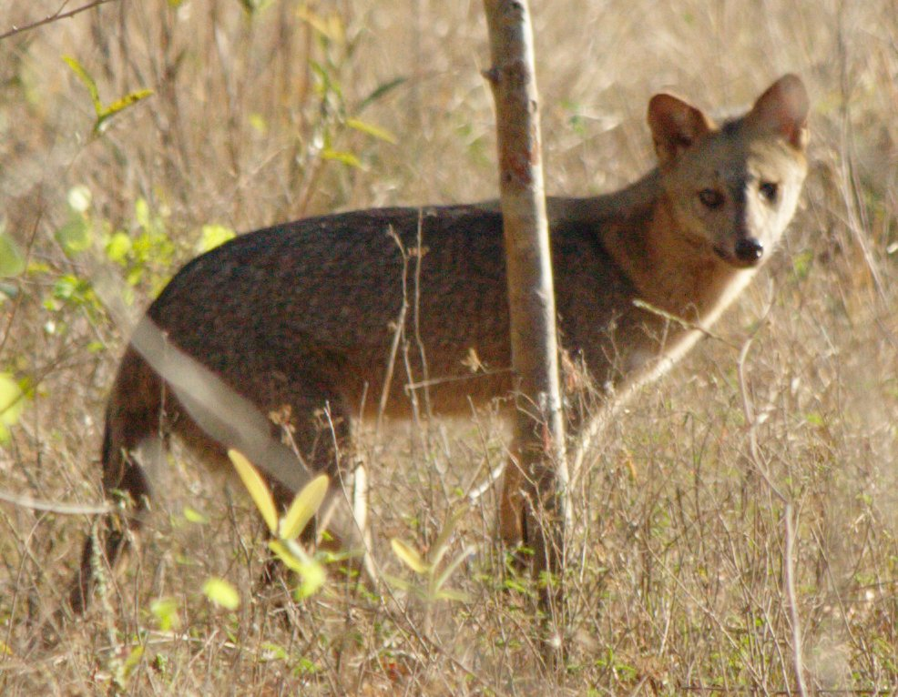
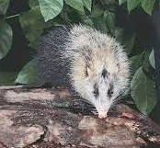
6- Crab-eating Fox
11- Moonrat
WaterFalls
Image Link
Image Link

Slide 24
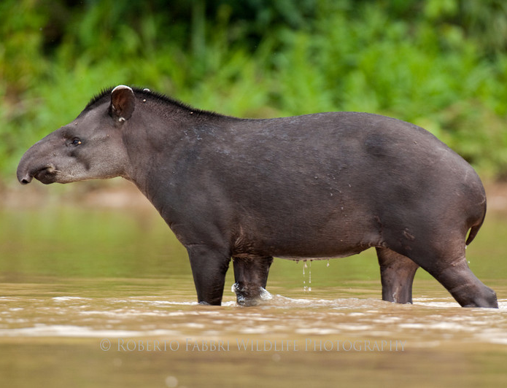
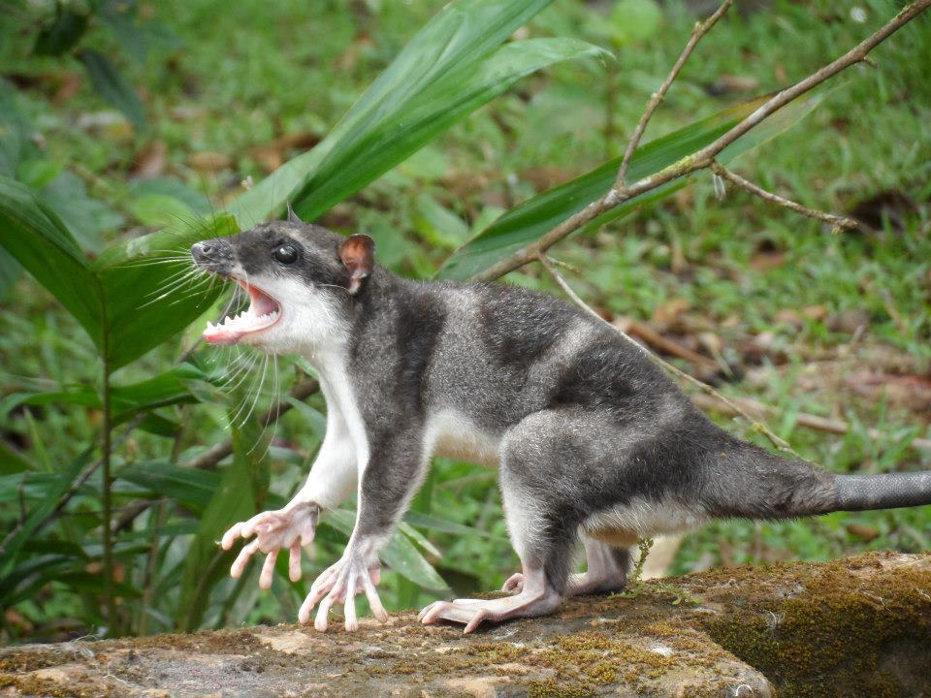
3- Lowland Tapir
14- Water Opossum
WaterFalls
Image Link
Image Link

Slide 25
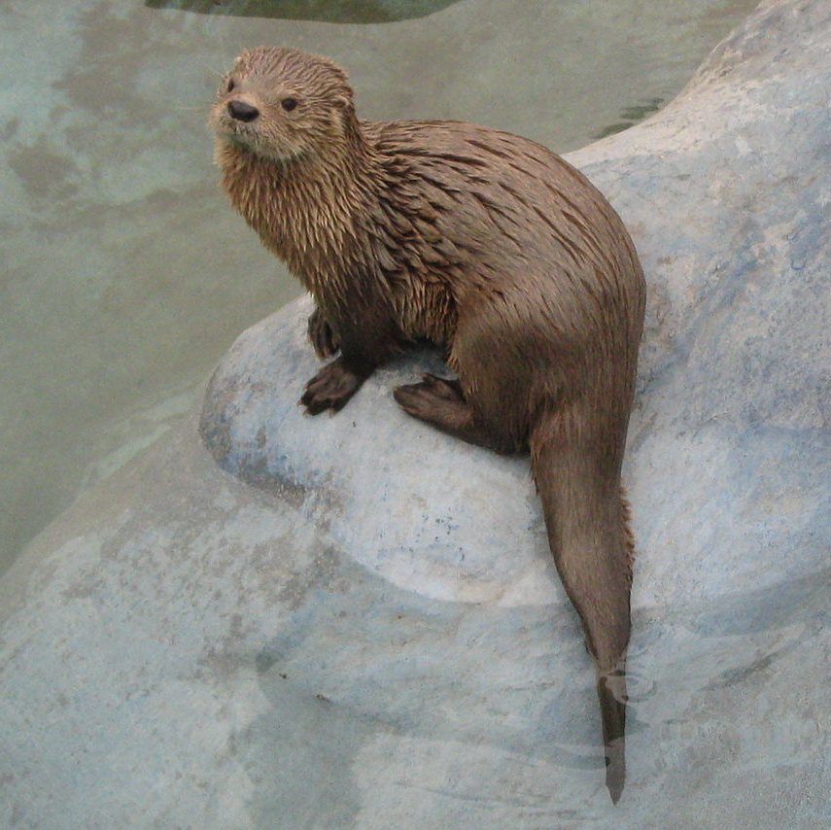
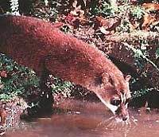
7- Marine Otter
10- Aquatic Genet
WaterFalls
Image Link
Image Link

Slide 26
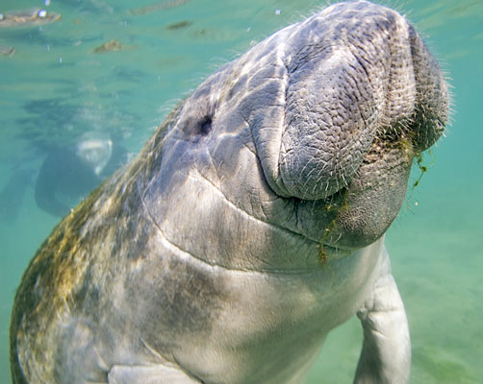
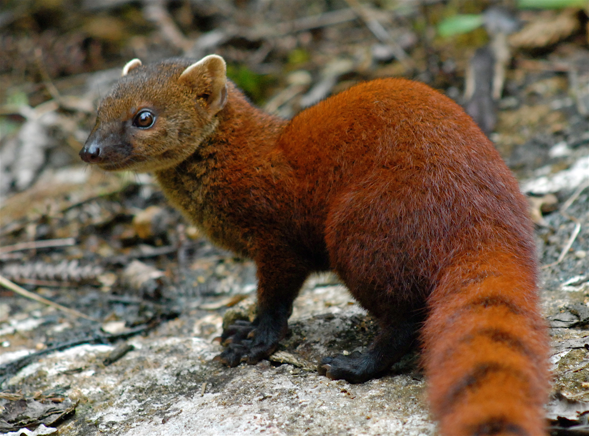
2- Manatee
15- Ring-tailed Vontsira
WaterFalls
Image Link
Image Link

Slide 28
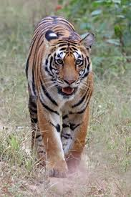
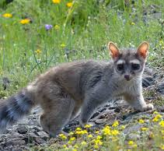
1- Bengal Tiger
16- Ringtail Cat
Jump Jump
Image Link
Tiger- Carolina Tiger Rescue
Image Link

Slide 29
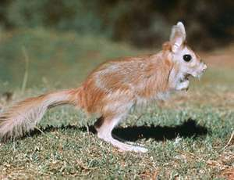
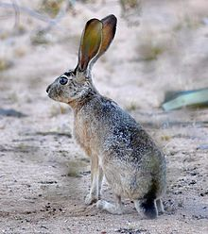
8- Springhare
9- Jackrabbit
Jump Jump
Image Link
Image Link

Slide 30
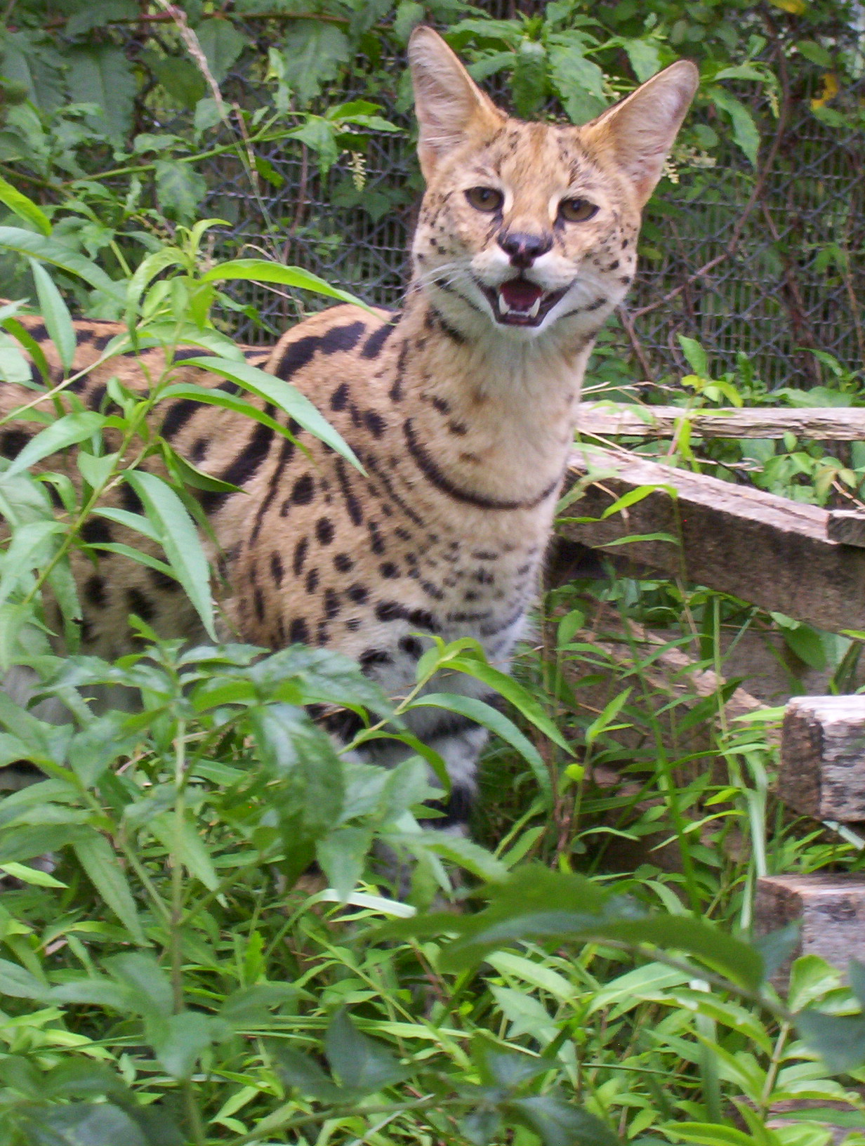
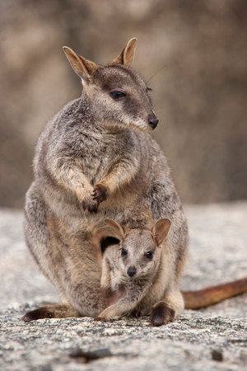
5- Serval
12- Rock Wallaby
Jump Jump
Image Link
Serval- Carolina Tiger Rescue
Image Link

Slide 31
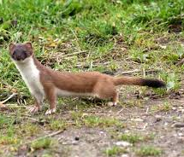
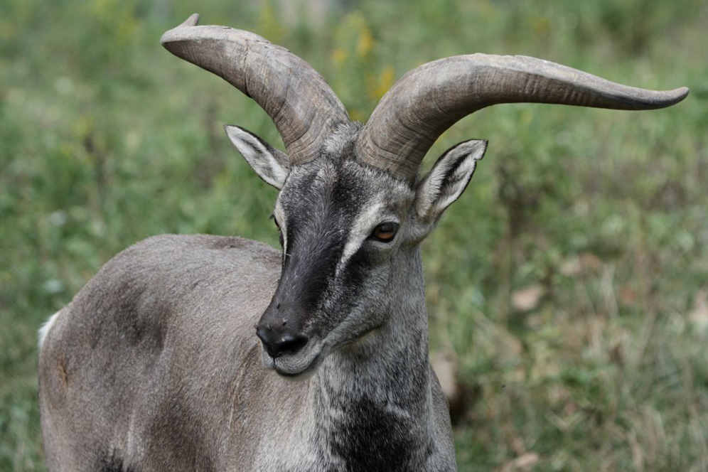
4- Bharal
13- Stoat
Jump Jump
Image Link
Image Link

Slide 32
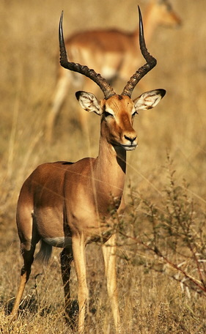
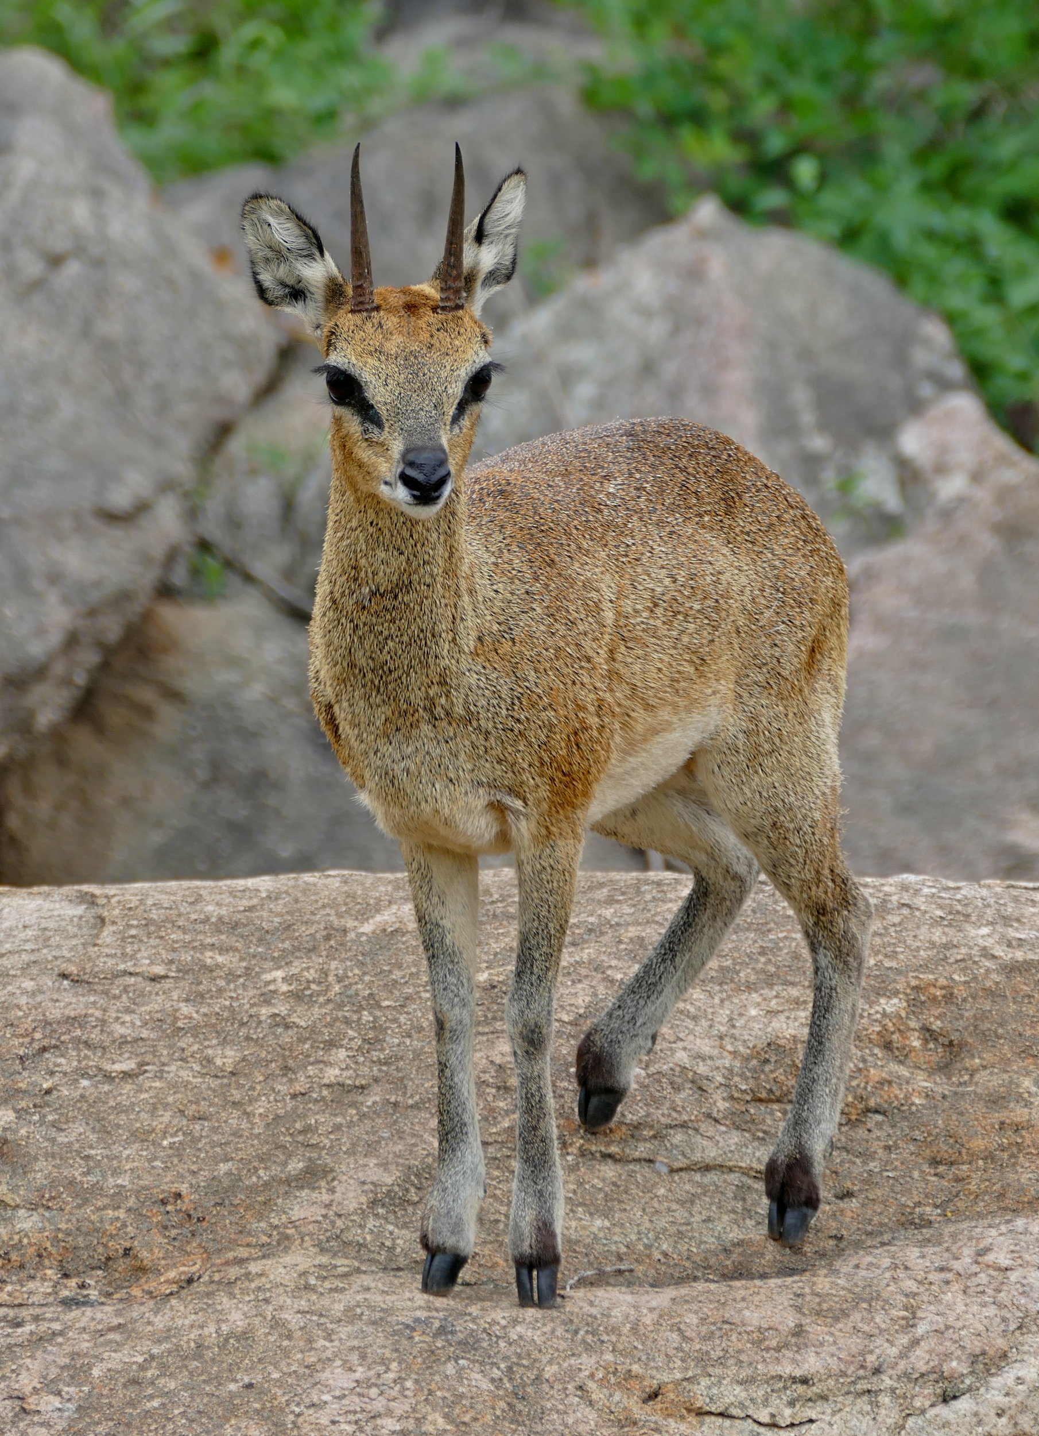
6- Impala
11- Klipspringer
Jump Jump
Image Link
Image Link

Slide 33
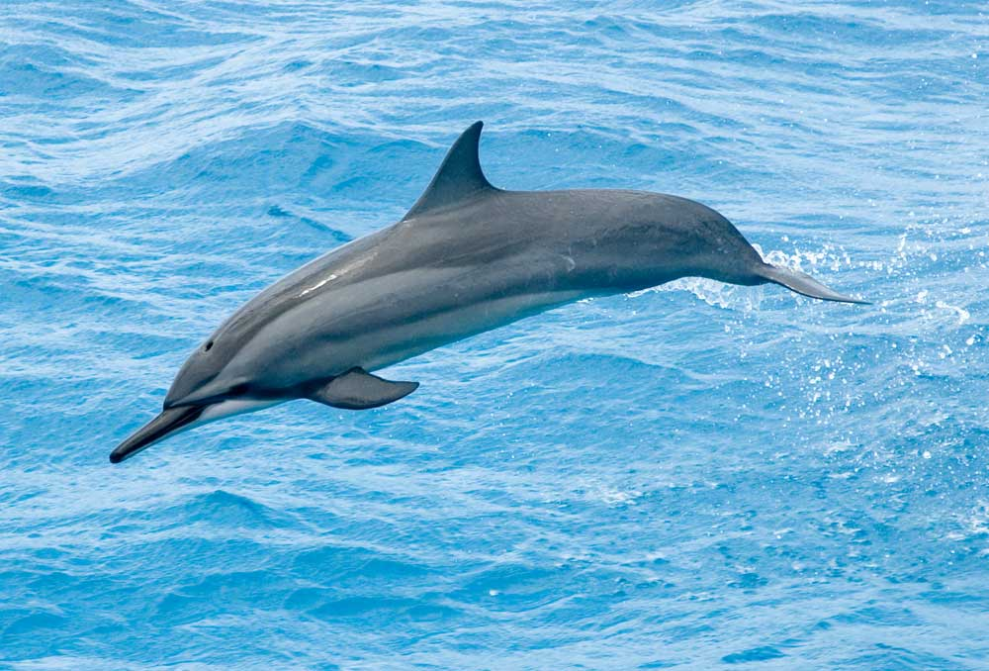
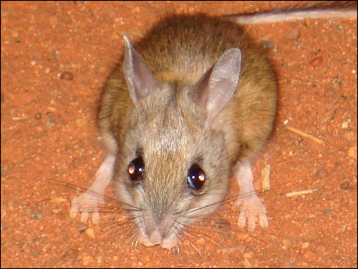
3- Spinner Dolphin
14- Spinifex hopping mouse
Jump Jump
Image Link
Image Link

Slide 34
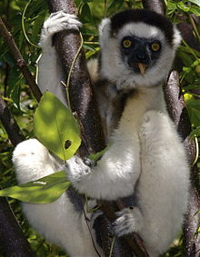
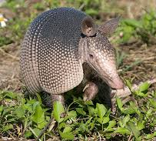
7- Sifaka
10- 9-Banded Armadillo
Jump Jump
Image Link
Image Link

Slide 35
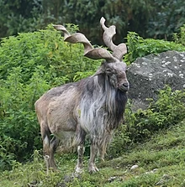
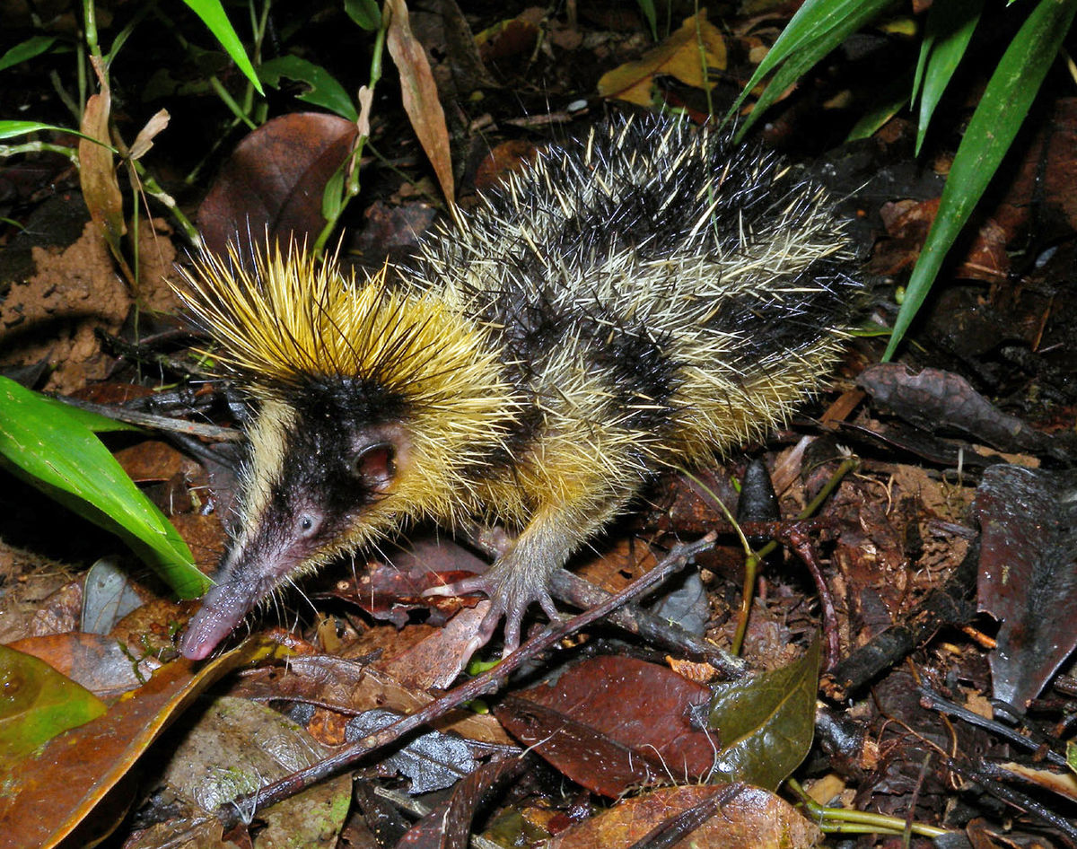
2- Markhor
15- Streaked Tenrec
Jump Jump
Image Link
Image Link

Slide 37
1- Zebra/ Oxpecker
16- Batfly/ Gammaproteobacteria
Tag Team
Image Link
Image Link

Slide 38
9- Goeldi’s Monkey/ Saddleback Tamarin/ White Lipped Tamarin
8- Aardvark/ Aardvark Cucumber
Tag Team
Image Link
Image Link

Slide 39
5- Crab and Sea Turtle
12- Clownfish/ Anemone
Tag Team
Image Link
Image Link

Slide 40
4- Wrasse/ Moray Eel
13- Fire Coral/ Algae
Tag Team
Image Link
Image Link

Slide 41
6- Diana Monkey/ Red Colobus
11- Bornean Bat/ Pitcher Plant
Tag Team
Image Link
Image Link

Slide 42
3- Banded Mongoose/ Warthog
14- Burying Beetles/ Phoretic Mites
Tag Team
Image Link
Image Link

Slide 43
7- Wattled Jacana/ Capybara
10- Fork-tailed Drongos/ Sociable Weaver
Tag Team
Image Link
Image Link

Slide 44
2- Coyote/ Badger
15- Ants/ Aphids
Tag Team
Image Link
Image Link

